Slide 1
Method Madness
An overview of population genomic methods for non-model organisms
BIO 594

Slide 2

Outline
A brief guide to multiple population genomic methods
RNAseq
Targeted Capture Methods
Ultra Conserved Elements
Exome Capture
Expressed Exome Capture (EecSeq)
Pooled Sequencing (PoolSeq)
Low Coverage Whole Genome Sequencing (lcWGS)
Live Coding
EecSeq data
lcWGS and genotype-likelihood based analyses
Final Project Plans!
BIO 594

Slide 3
Final Projects!
Final Projects (50%)
The culmination of this course will be the completion of a final Population Genomics Project. Each student must analyze a NGS data set from raw sequencing files to a completed population level analysis. Students are encouraged to use their own data sets, but students can also use an actual data set of Dr. Puritz or a simulated data set. Projects can be completed on a different computing system or may use software and packages not discussed in the course, but all analyses and results must be documented and repeatable.
Project Plan and Approval (10 points)
A detailed outline of the proposed data set and analyses must be submitted and approved by Dr. Puritz by 4/11/19
Analysis (20 points)
All bioinformatic are properly completed
Appropriate population genomic analyses are utilized and properly completed
Documentation (20 points)
All work must be fully documented and repeatable on the class Github account
This includes markdown style documentation and executable scripts for each analysis component

Slide 4
It’s not a bracket!
EecSeq
RADseq
EecSeq
RNAseq
RNAseq
EecSeq
PoolSeq
lcWGS
lcWGS
lcWGS
Target Capture

Slide 5
Population Genomics for non-model organisms
Aim of Study | Optimal sequencing method
Population subdivision, migration rates, population size changes through time | RAD
Genes under selection | Exome Sequencing
Selection signatures and genomic regions underlying ecological speciation | Low-coverage WGS PoolSeq (less optimal)
Molecular basis of acclimatization, adaptation | RNAseq or TagSeq
Genome-wide DNA methylation and Epigenetic inference | MBD-Seq, MethylRAD, EpiRAD
Adapted from Matz 2018

Slide 6
Population Genomics for non-model organisms
Aim of Study | Optimal sequencing method | Minimal Reference Needed
Population subdivision, migration rates, population size changes through time | RAD | None
Genes under selection | Exome Sequencing | De novo transcriptome Soon to be none with EecSeq
Selection signatures and genomic regions underlying ecological speciation | Low-coverage WGS PoolSeq (less optimal) | Draft genome
Molecular basis of acclimatization, adaptation | RNAseq or TagSeq | None or De novo transcriptome
Genome-wide DNA methylation and Epigenetic inference | MBD-Seq, MethylRAD, EpiRAD | None for the two RAD approaches, otherwise de novo transcriptome
Adapted from Matz 2018

Slide 7
Population Genomics for non-model organisms
Aim of Study | Optimal sequencing method | Minimal Reference Needed
Population subdivision, migration rates, population size changes through time | RAD | None
Genes under selection | Exome Sequencing | De novo transcriptome Soon to be none with EecSeq
Selection signatures and genomic regions underlying ecological speciation | Low-coverage WGS PoolSeq (less optimal) | Draft genome
Molecular basis of acclimatization, adaptation | RNAseq or TagSeq | None or De novo transcriptome
Genome-wide DNA methylation and Epigenetic inference | MBD-Seq, MethylRAD, EpiRAD | None for the two RAD approaches, otherwise de novo transcriptome
Adapted from Matz 2018

Slide 8
Population Genomics for non-model organisms
Aim of Study | Optimal sequencing method | Minimal Reference Needed
Population subdivision, migration rates, population size changes through time | RAD | None
Genes under selection | Exome Sequencing | De novo transcriptome Soon to be none with EecSeq
Selection signatures and genomic regions underlying ecological speciation | Low-coverage WGS PoolSeq (less optimal) | Draft genome
Molecular basis of acclimatization, adaptation | RNAseq or TagSeq | None or De novo transcriptome
Genome-wide DNA methylation and Epigenetic inference | MBD-Seq, MethylRAD, EpiRAD | None for the two RAD approaches, otherwise de novo transcriptome
Adapted from Matz 2018

Slide 9
The basics
Gene
Exon
Intron
mRNA
Protein

Slide 10
RNAseq
RNAseq focuses on sequencing RNA directly
Gene
Exon
Intron
RNA
Protein

Slide 11
RNAseq
RNAseq focuses on sequencing RNA directly
RNA

Slide 12
RNAseq
RNAseq focuses on sequencing RNA directly
RNA

Slide 13
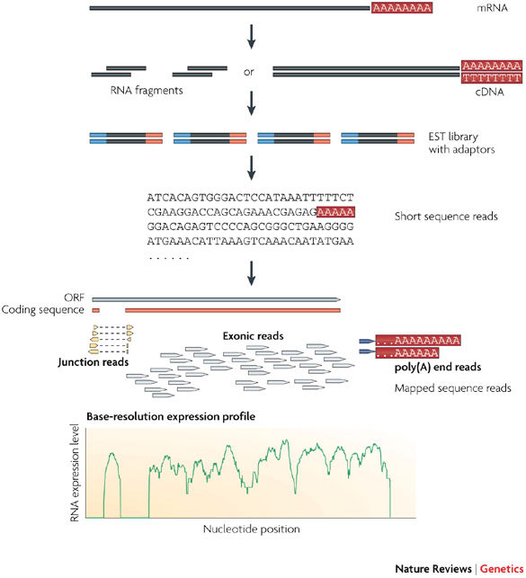
RNAseq
RNAseq focuses on sequencing RNA directly
Identify transcripts and quantify gene expression
Obtain “transcriptome”: snapshot of expression of all genes a time point
Conesa et al., 2016; Wang et al., 2009

Slide 14
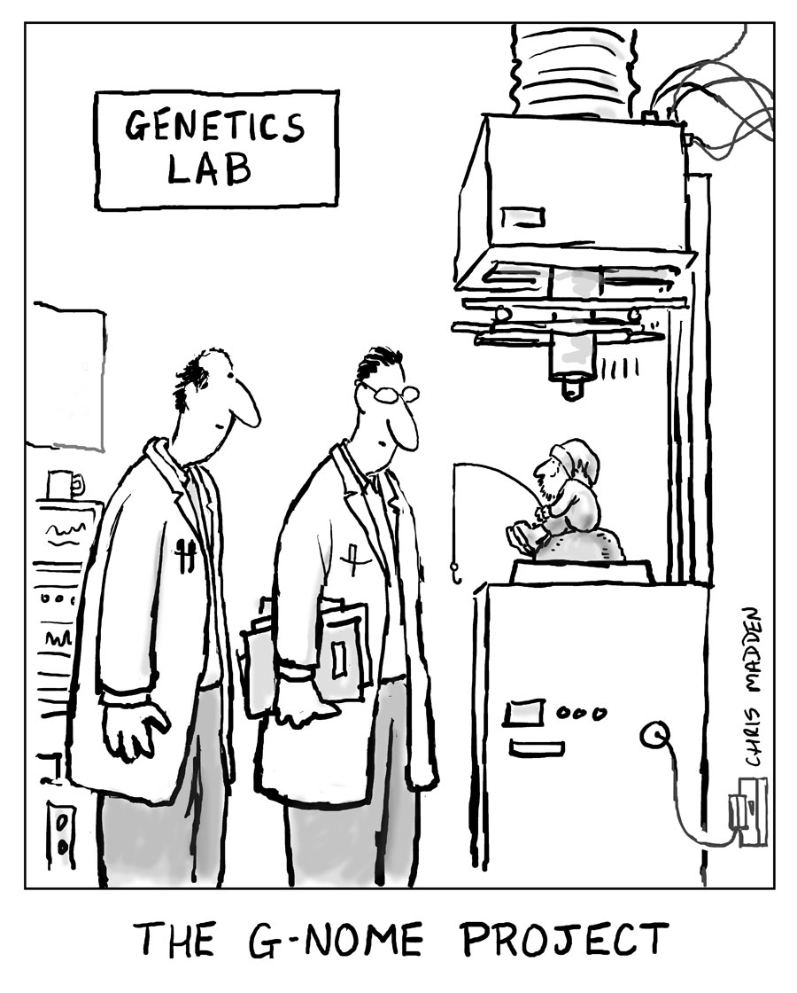
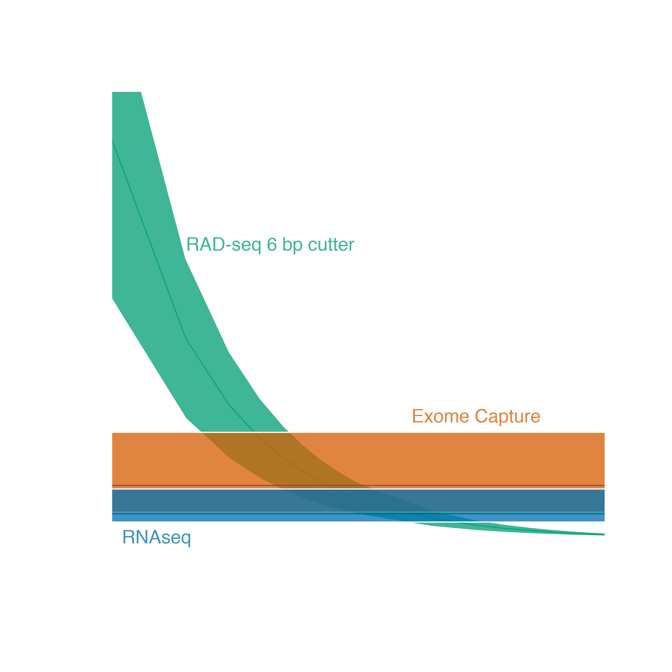
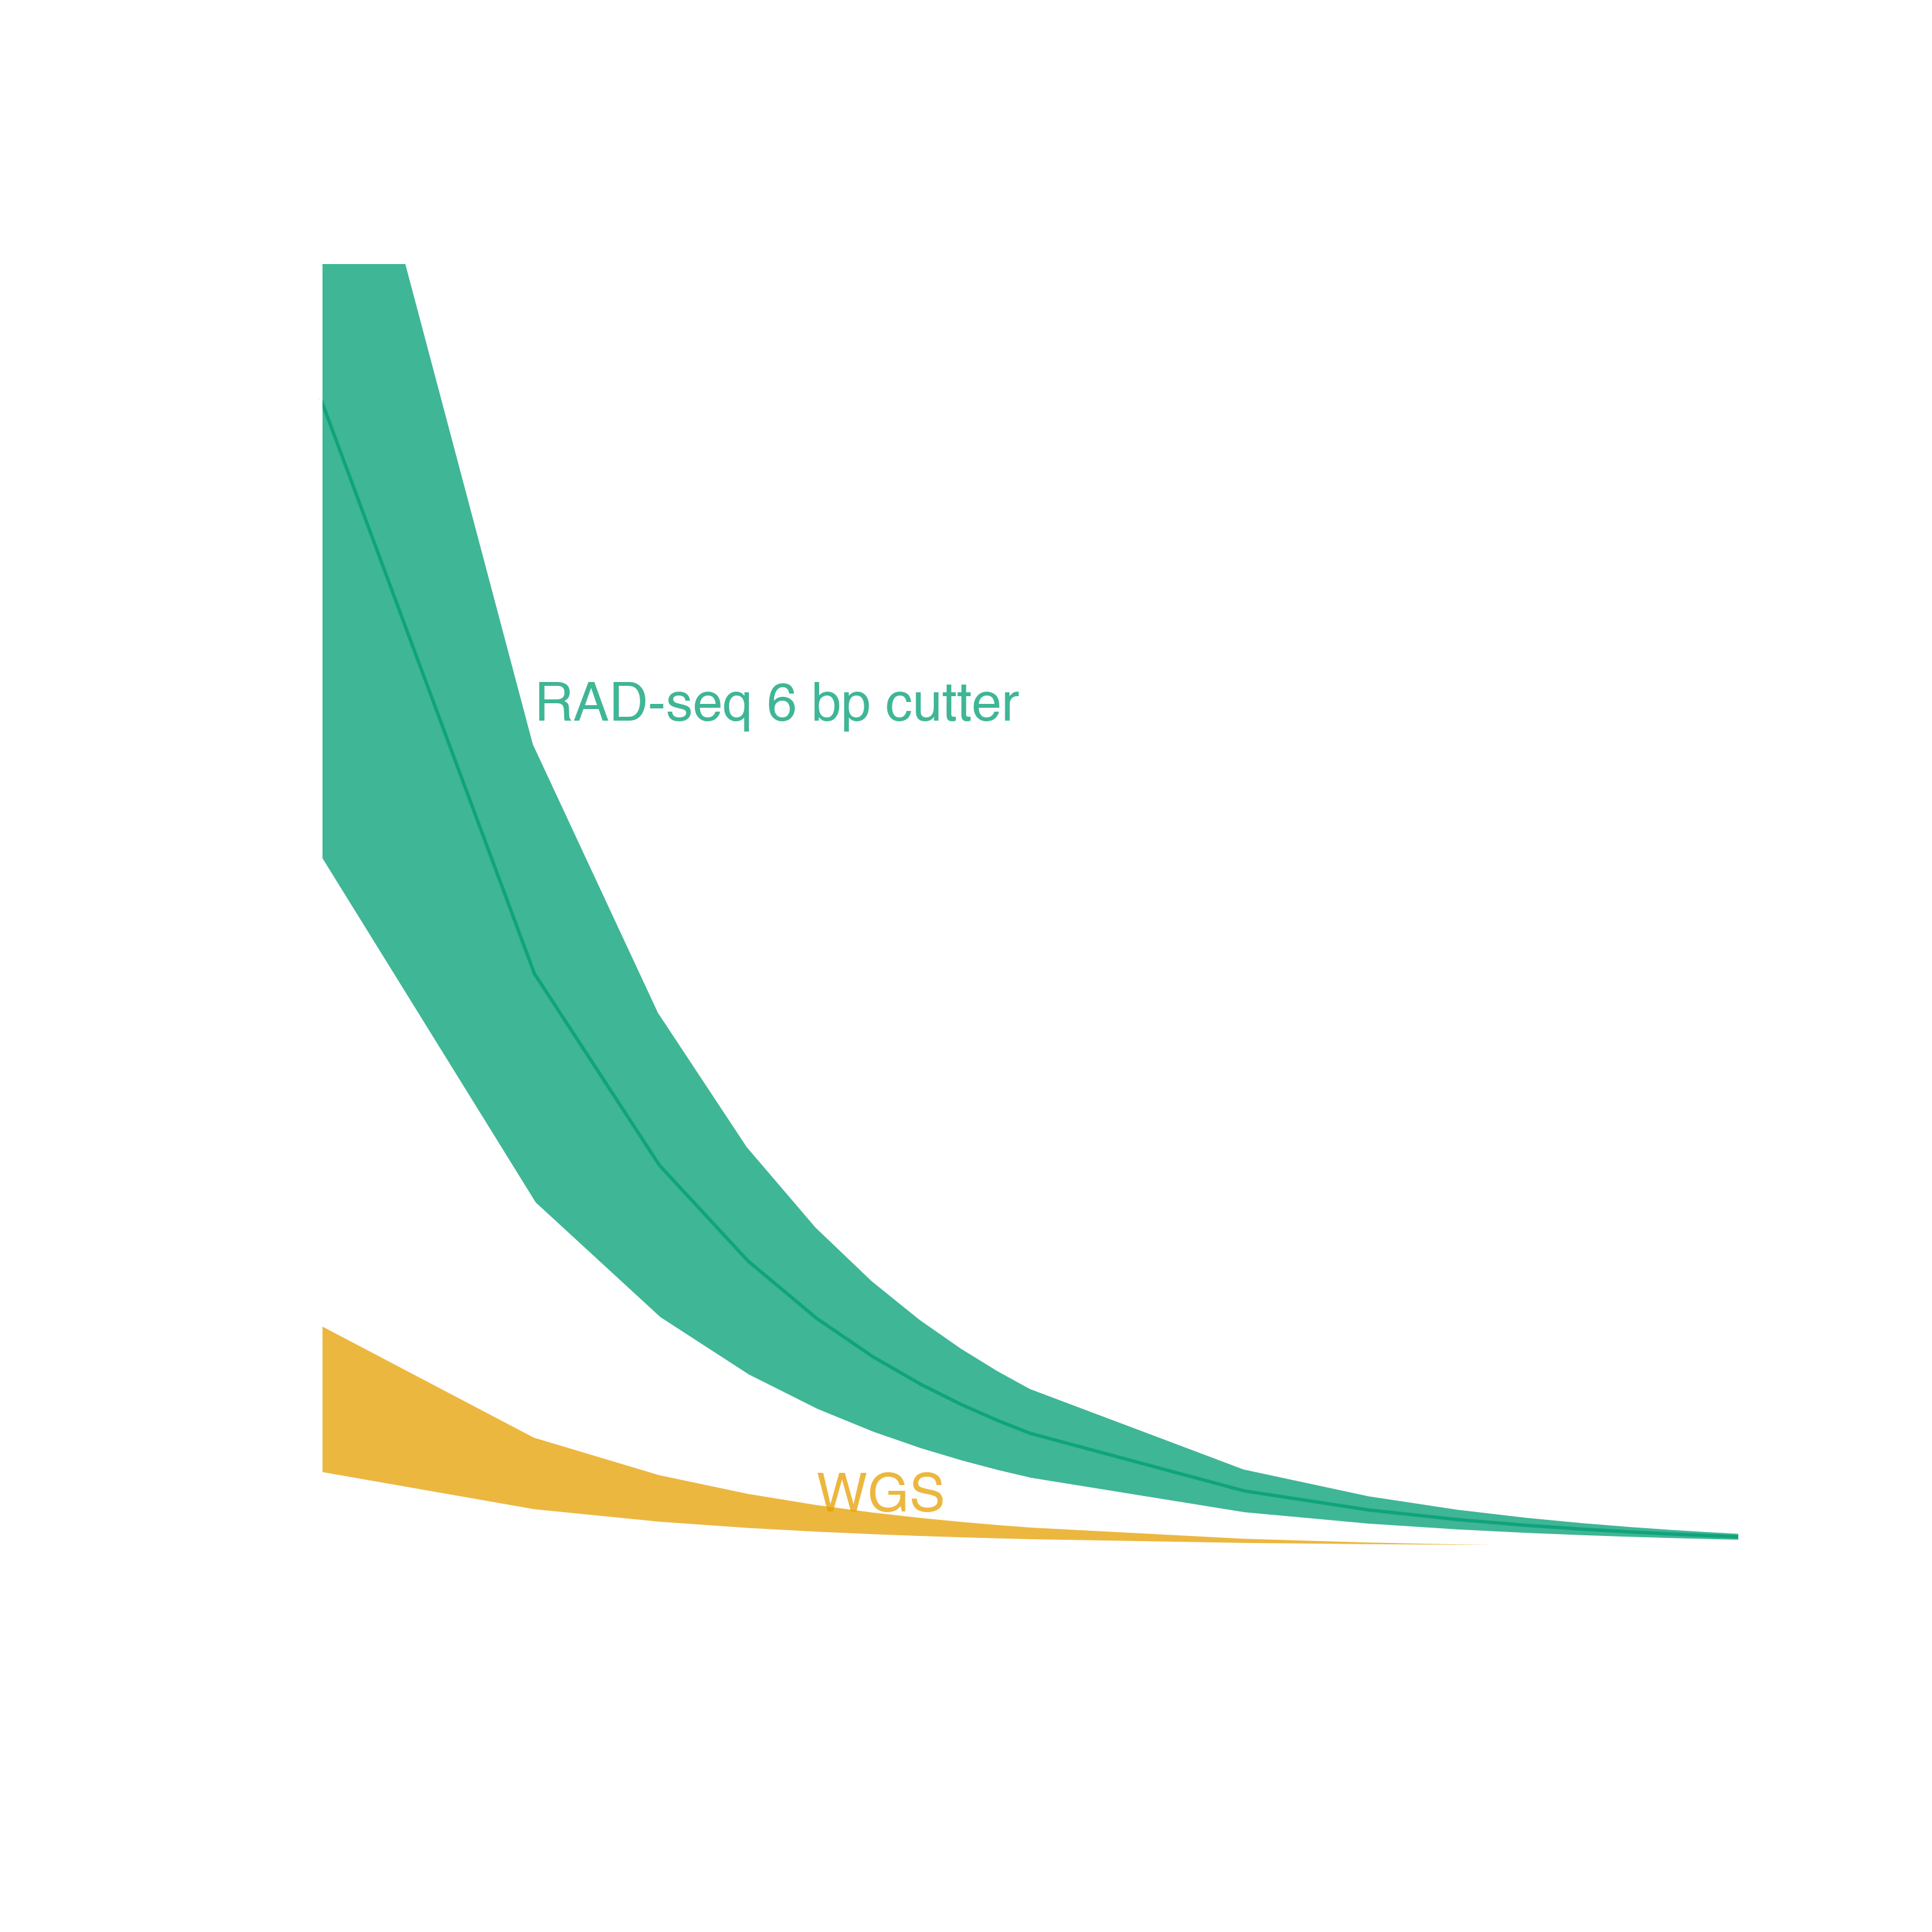
Genome reduction options
With genomic resources
Targeted capture
Ultra Conserved Elements
Exome Capture
Adapted from Lowry et al. 2016

Slide 15
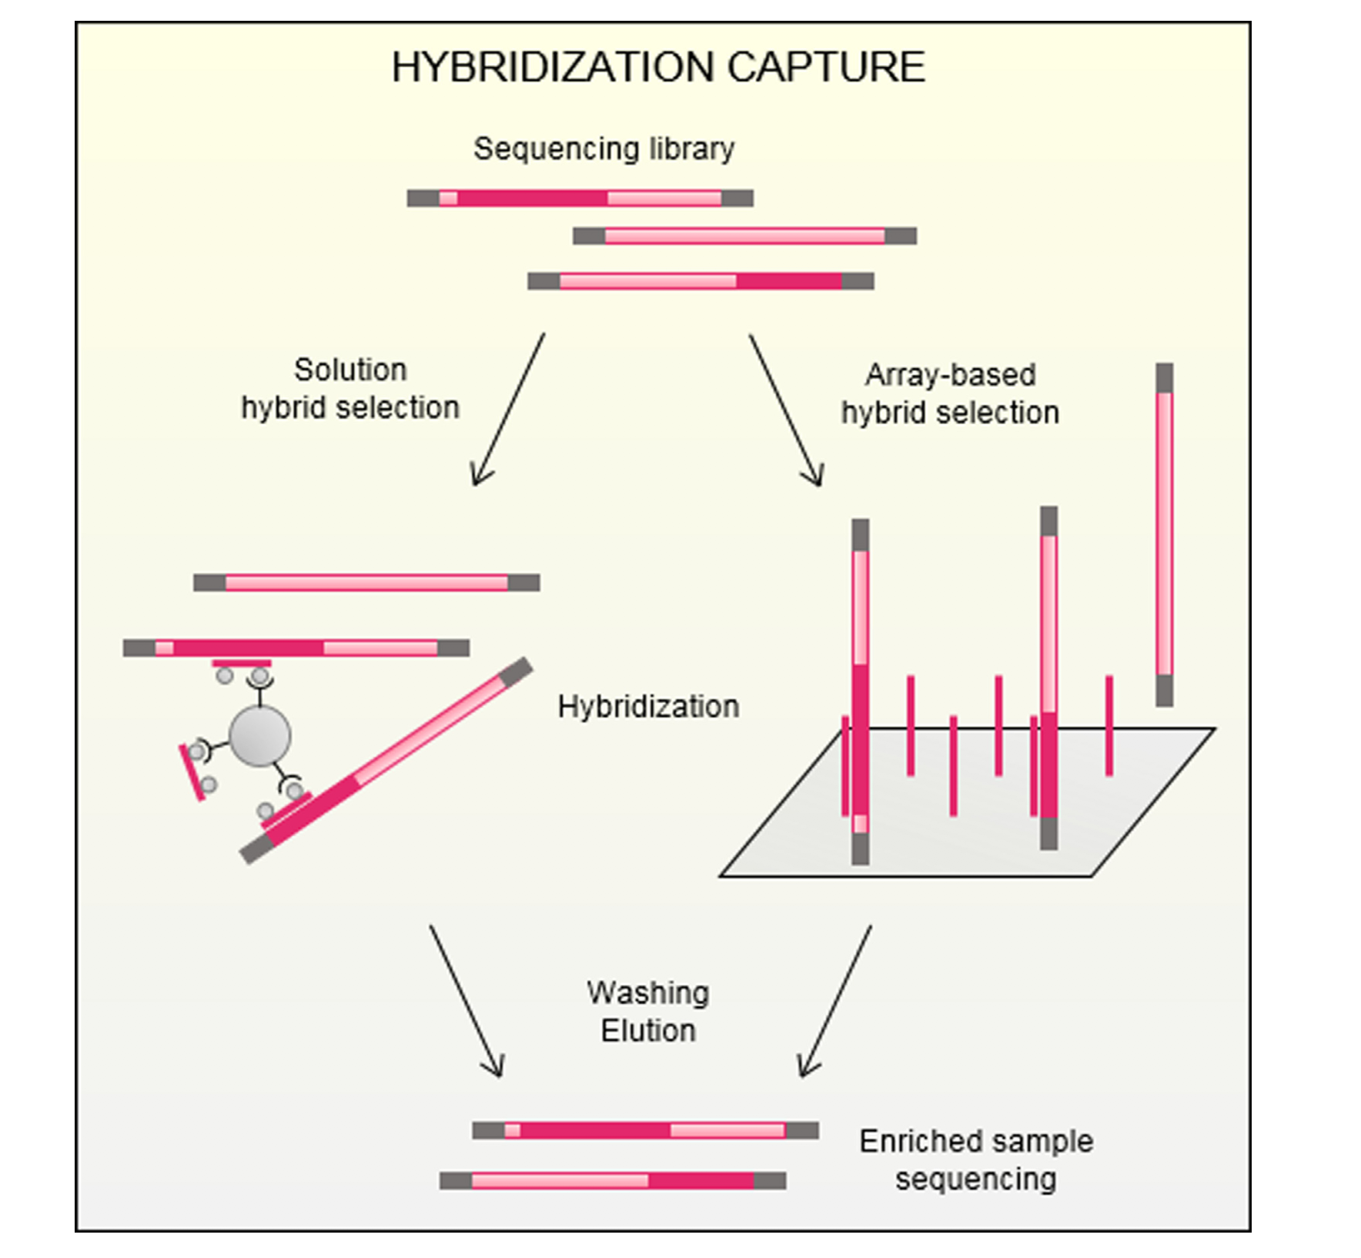
What is targeted capture?
All targeted capture involves first making a shotgun gDNA library
Reduced representation comes from hybridization to targeted probes
Does NOT rely on enzymatic treatment
The number of probes is known and can be fully customized
Gasc et al. 2016
BIO 594

Slide 16
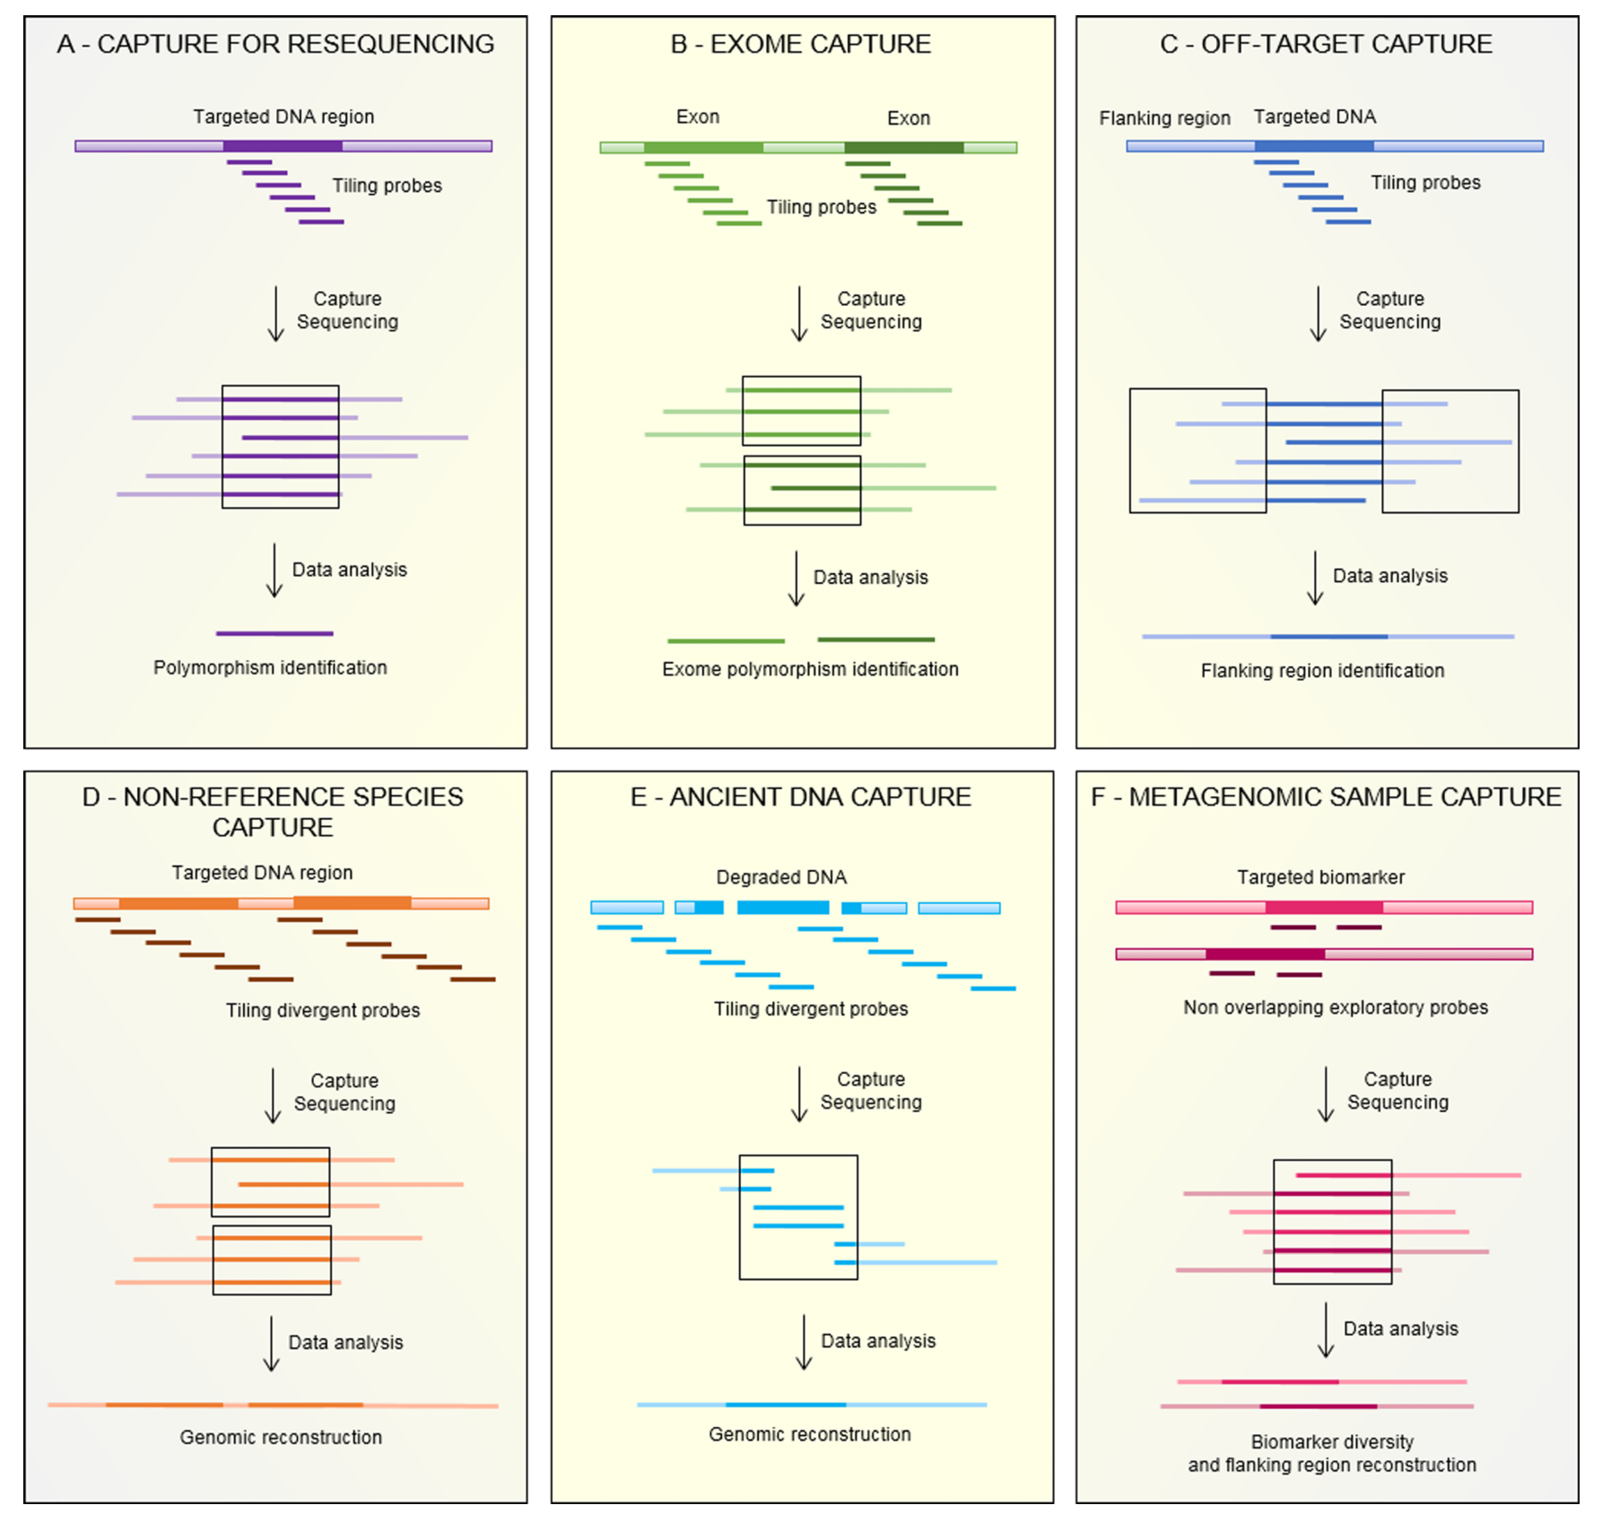
What is targeted capture?
Customization allows for a variety of applications
Dependent on research question
Involves both the number of targets and the number of probes per target
Gasc et al. 2016
BIO 594

Slide 17
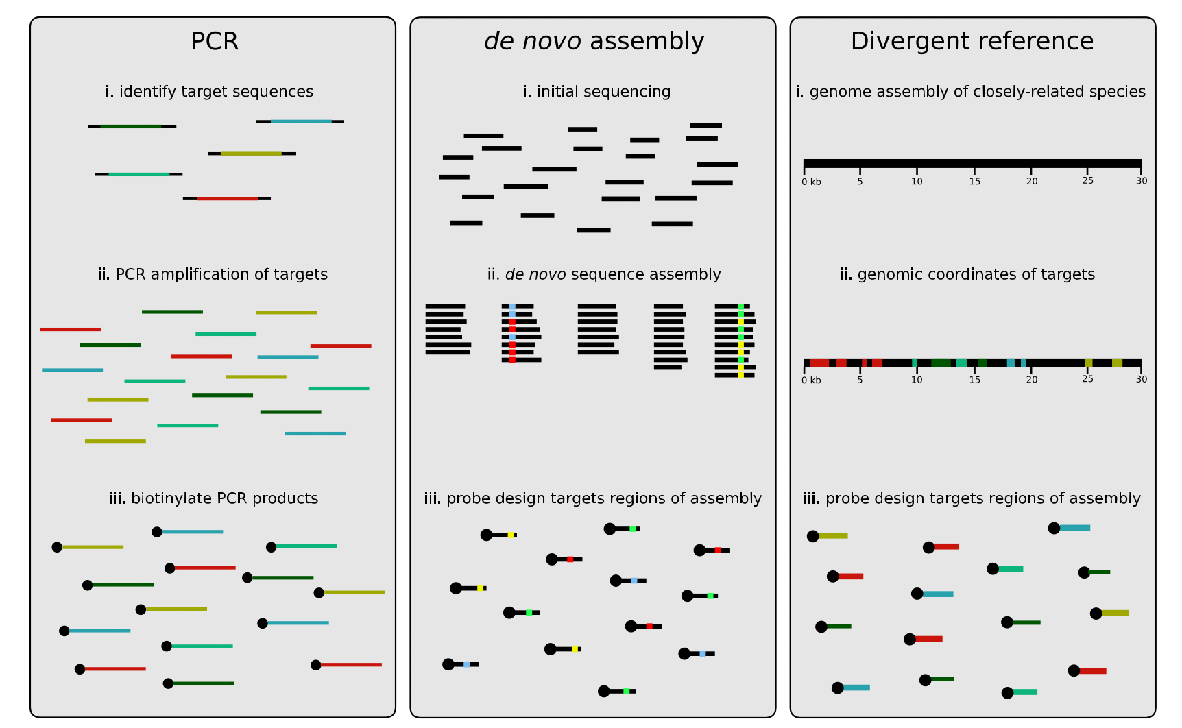
What is targeted capture?
Jones and Good 2016
BIO 594

Slide 18
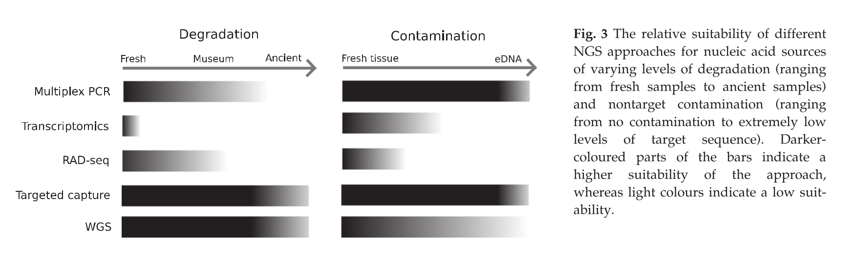
Why use targeted capture?
Jones and Good 2016
BIO 594

Slide 19
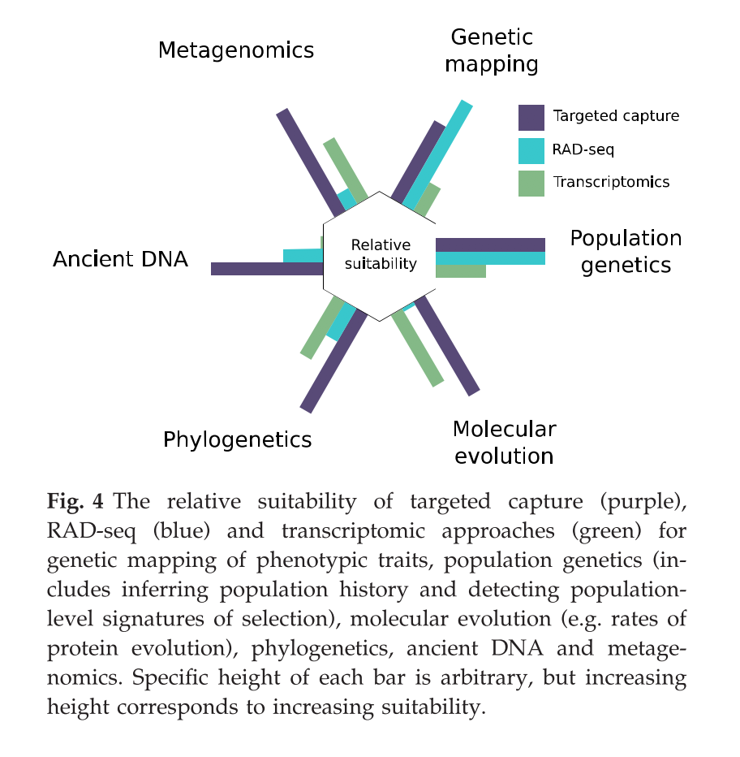
Why use targeted capture?
Jones and Good 2016
BIO 594

Slide 20
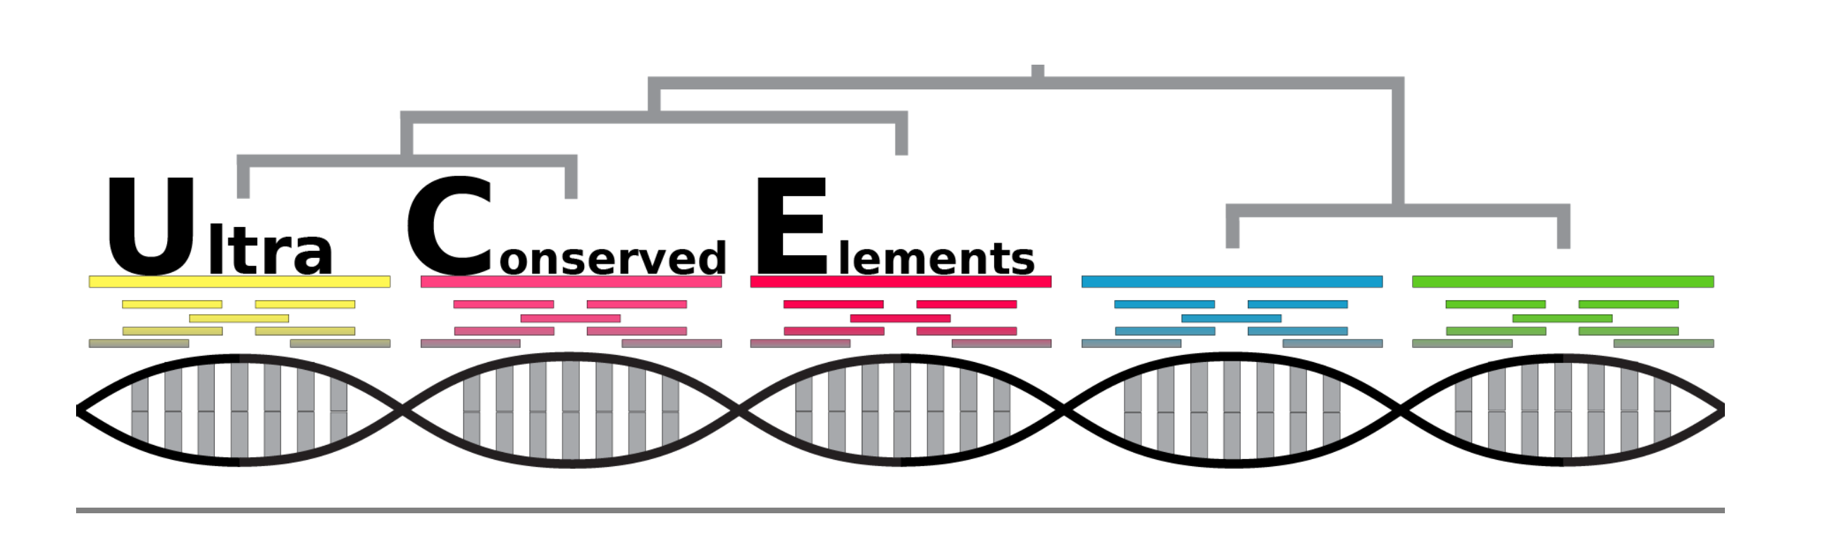
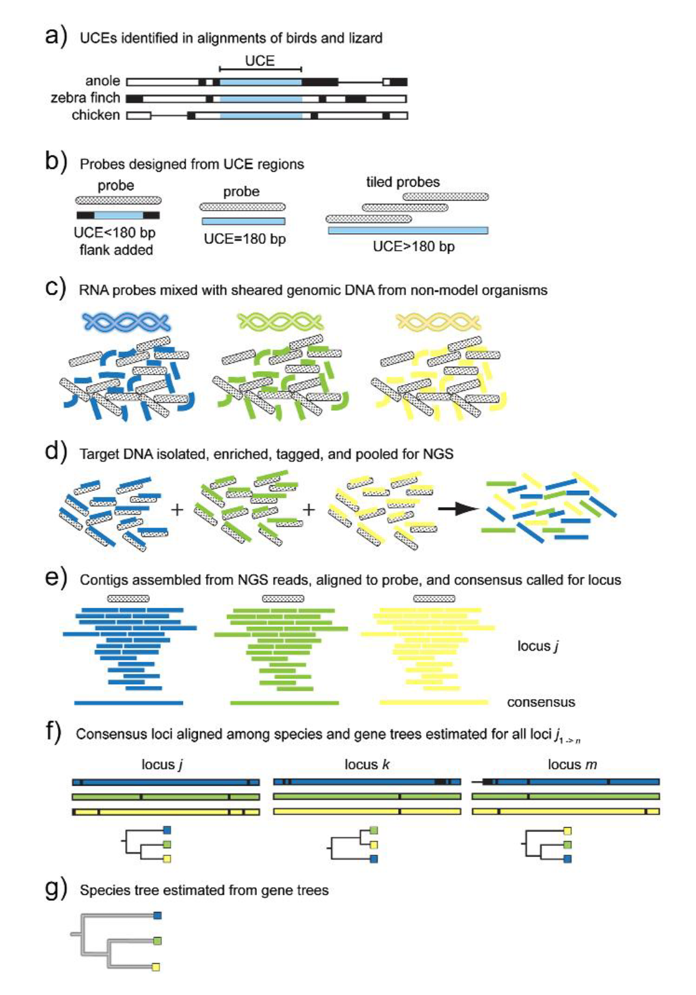
Ultra Conserved Elements
UCEs
highly conserved regions of organismal genomes shared among evolutionary distant taxa
Uses-
data from UCEs and the DNA adjacent to UCE locations (flanking DNA), and that these data are useful for reconstructing the evolutionary history and population-level relationships of many organisms
http://ultraconserved.org
Faircloth et al. 2012
BIO 594

Slide 21
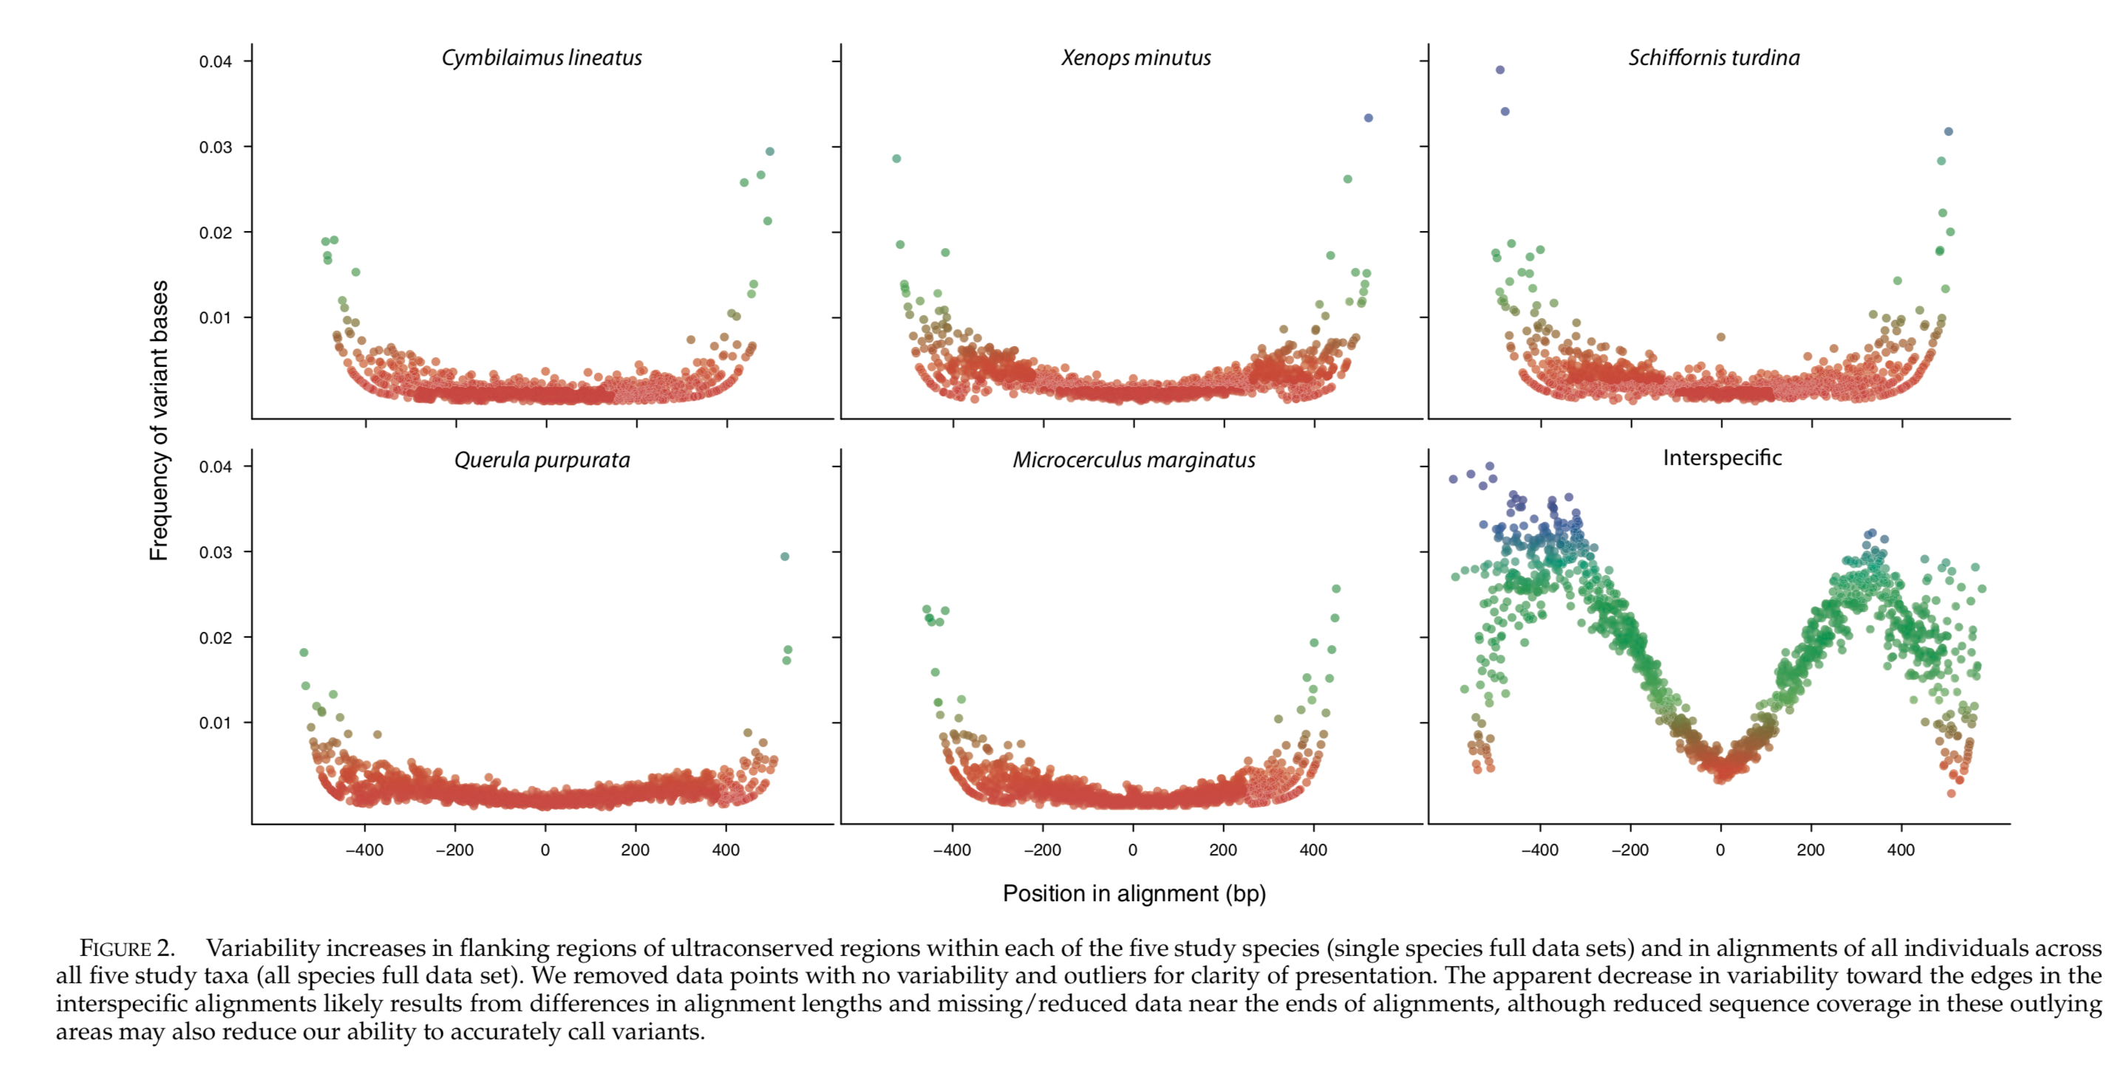
Ultra Conserved Elements
Smith et al. 2014
BIO 594

Slide 22
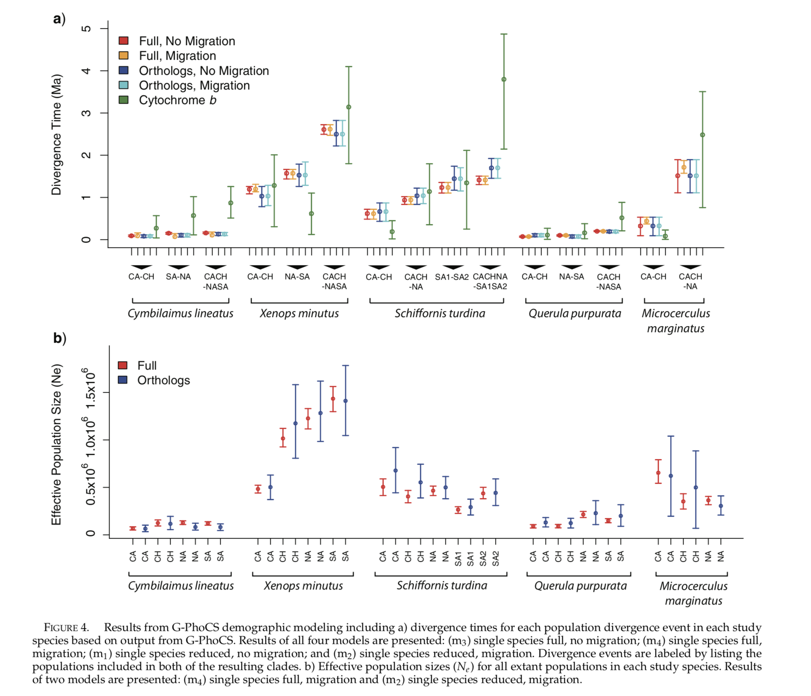
Ultra Conserved Elements
Smith et al. 2014
BIO 594

Slide 23
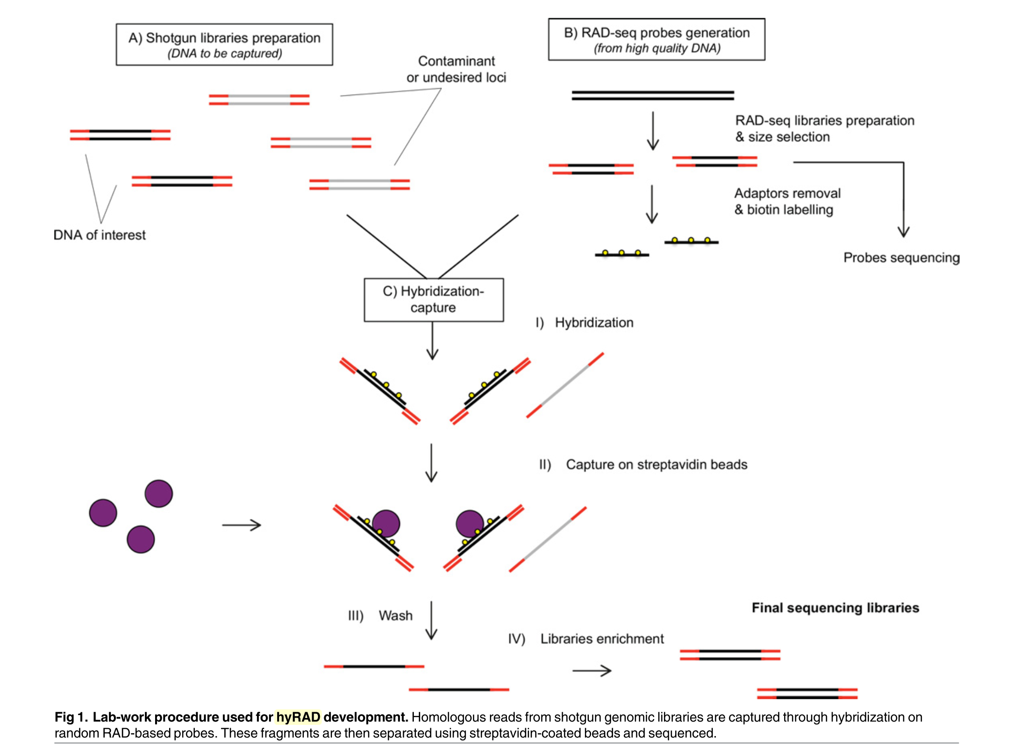
RAD capture, Rapture, hyRAD, hyRAD-X
Suchan et al. 2016
BIO 594

Slide 24
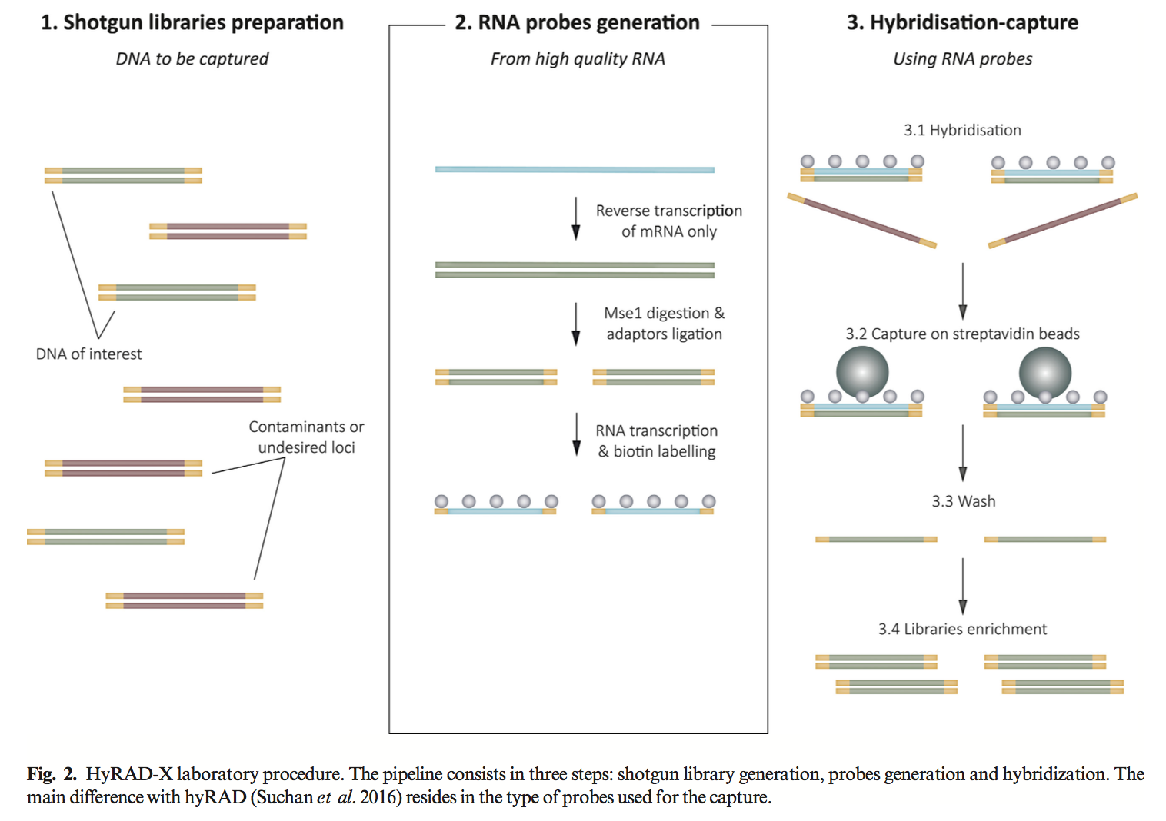
RAD capture, Rapture, hyRAD, hyRAD-X
Schmid et al. 2017
BIO 594

Slide 25
Exome capture
BIO 594

Slide 26
Exome vs genome

Slide 27
Exome vs genome

Slide 28
Exome capture
Exome capture focuses sequencing on the portions of the genome that lead to changes in protein function
BIO 594

Slide 29
The exome: the ultimate genome reduction
RADseq
Cheap
May not sample target genes

Slide 30
The exome: the ultimate genome reduction
RADseq
Cheap
May not sample target genes
RNAseq
Relatively expensive

Slide 31
The exome: the ultimate genome reduction
RADseq
Cheap
May not sample target genes
RNAseq
Relatively expensive

Slide 32
The exome: the ultimate genome reduction
RADseq
Cheap
May not sample target genes
RNAseq
Relatively expensive
Allele specific expression

Slide 33
The exome: the ultimate genome reduction
RADseq
Cheap
May not sample target genes
RNAseq
Relatively expensive
Allele specific expression

Slide 34
The exome: the ultimate genome reduction
RADseq
Cheap
May not sample target genes
RNAseq
Relatively expensive
Allele specific expression
Exome capture
Requires an annotated transcriptome, preferably genome
Requires synthesized probes

Slide 35
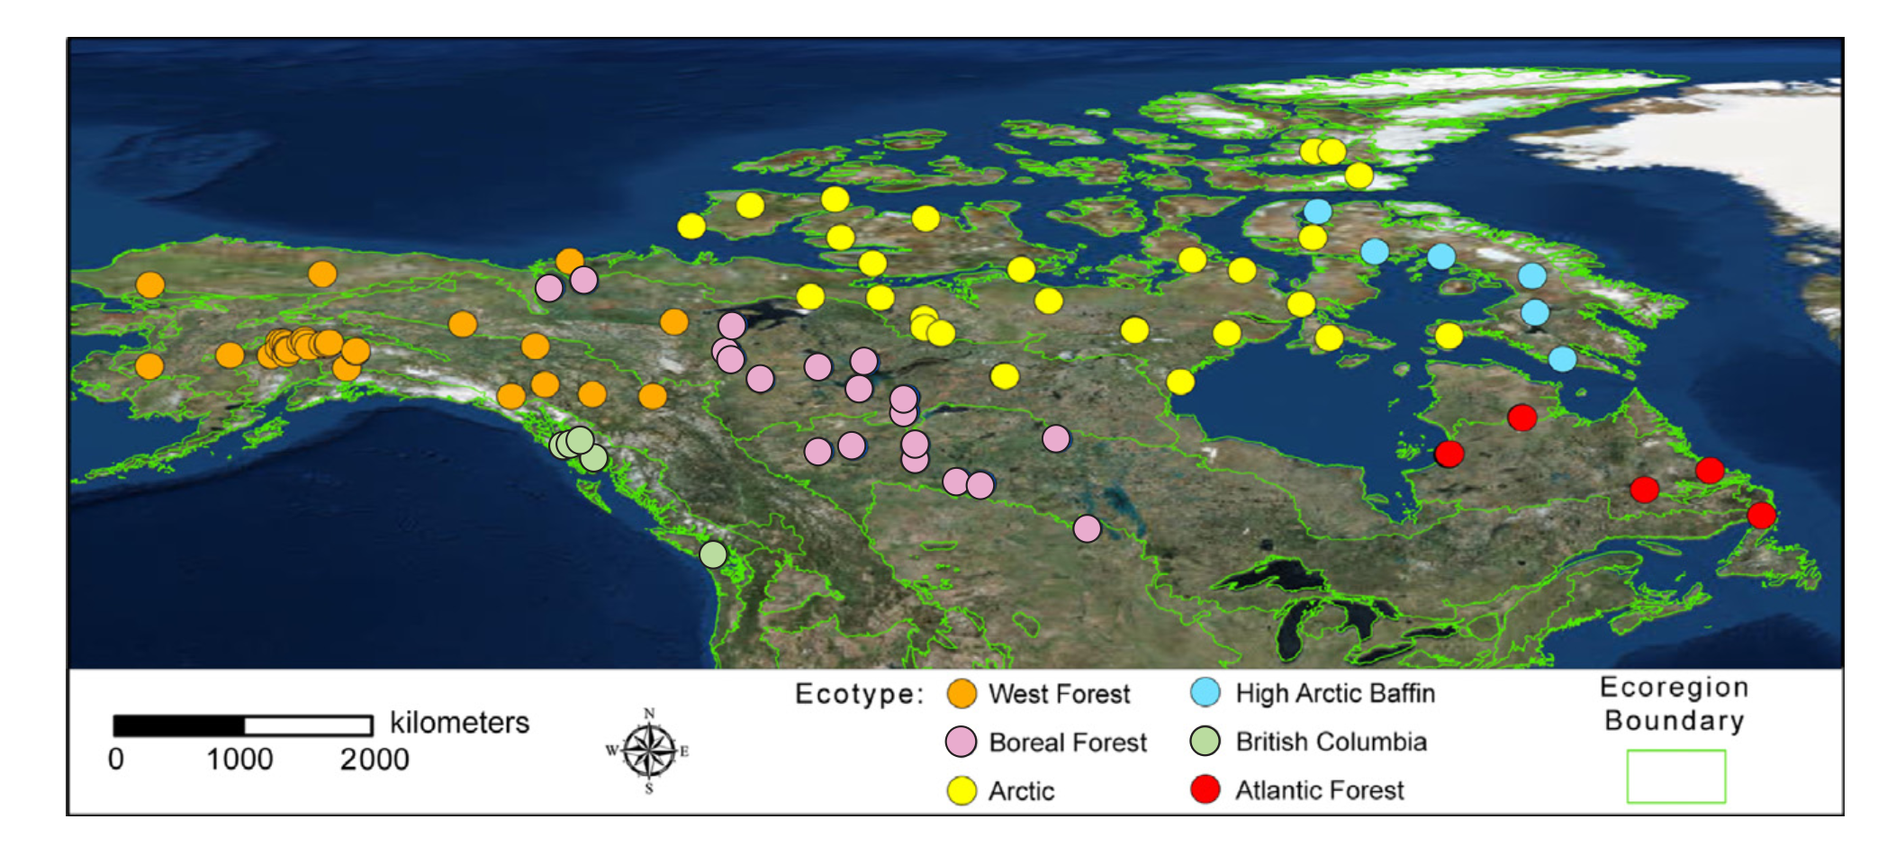
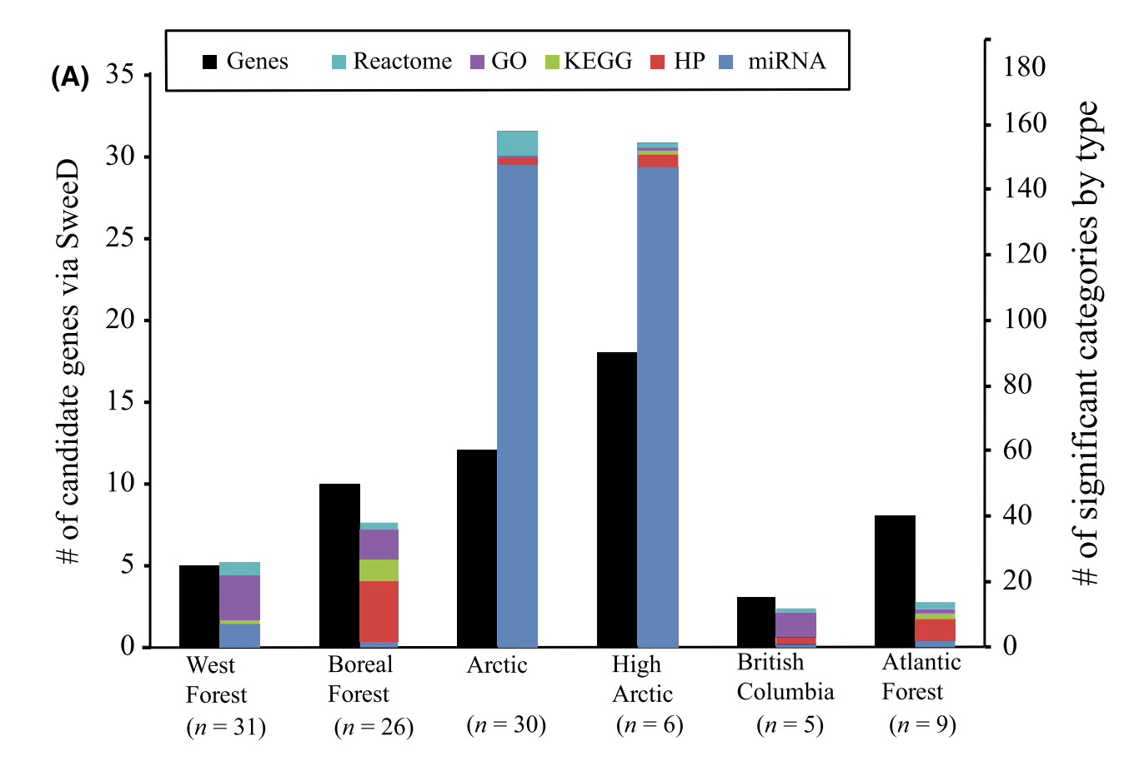
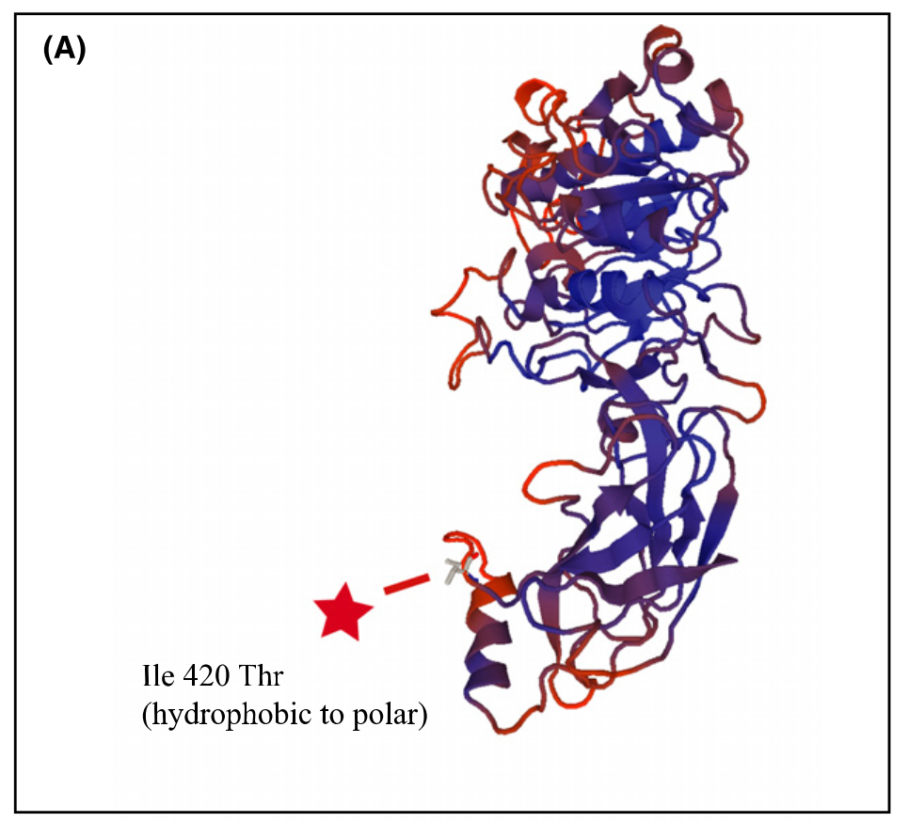
Exome capture
Schweizer et al. 2016
BIO 594

Slide 36

Traditional exome capture
Probes
Hybridize to DNA library
Capture
Wash, elute, PCR enrich
Sequence

Slide 37
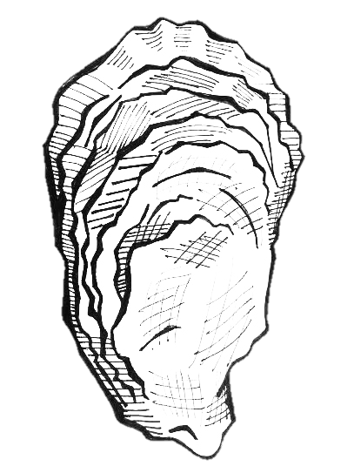
Expressed exome capture sequencing
Probes
Hybridize to DNA library
Capture
Wash, elute, PCR enrich
Sequence

Slide 38
EecSeq
Use expressed mRNA to probe the exome
Remove the need for a previously sequenced transcriptome
Remove the cost and time associated with probe synthesis
EecSeq!

Slide 39
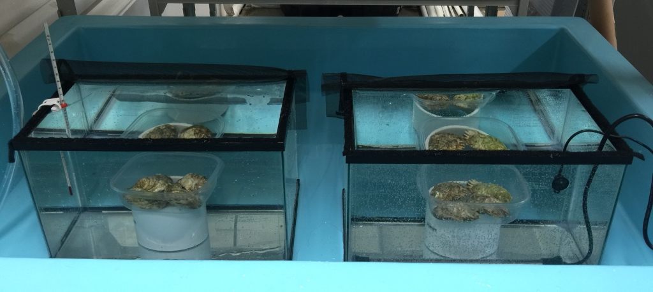
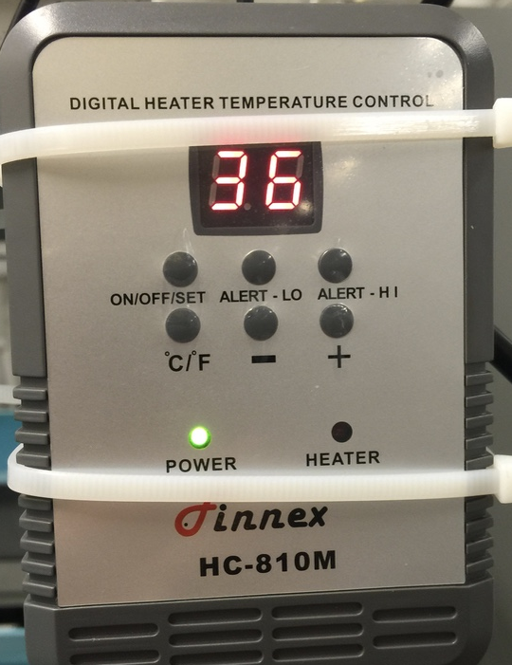
EecSeq: Proof of Concept
Simple heat shock exposure
4 exposed individuals at 36 ºC for 1 hour
4 control individuals at ambient (12 ºC for 1 hour)

Slide 40

Control oysters
DNA extraction
RNA extraction
Exposed
oysters
Shotgun library preparation
mRNA library preparation
Exon loci
Custom Adapters
Hybridization
Genomic Library
Non-target loci does not hybridize
Adapter removal and biotin labeling
DSN Normalization
Non-target loci
Probe
Probes
Saved for transcriptome sequencing
Exome capture
Biotin
Streptavidin bead
Exon loci
Wash and elution
PCR
Enrichment
Exome sequencing

Slide 41
Sequencing
6 replicate captures of 8 individuals
Original probes
Original probes plus 12 additional rounds of PCR
~48% of reads mapping to exons

Slide 42
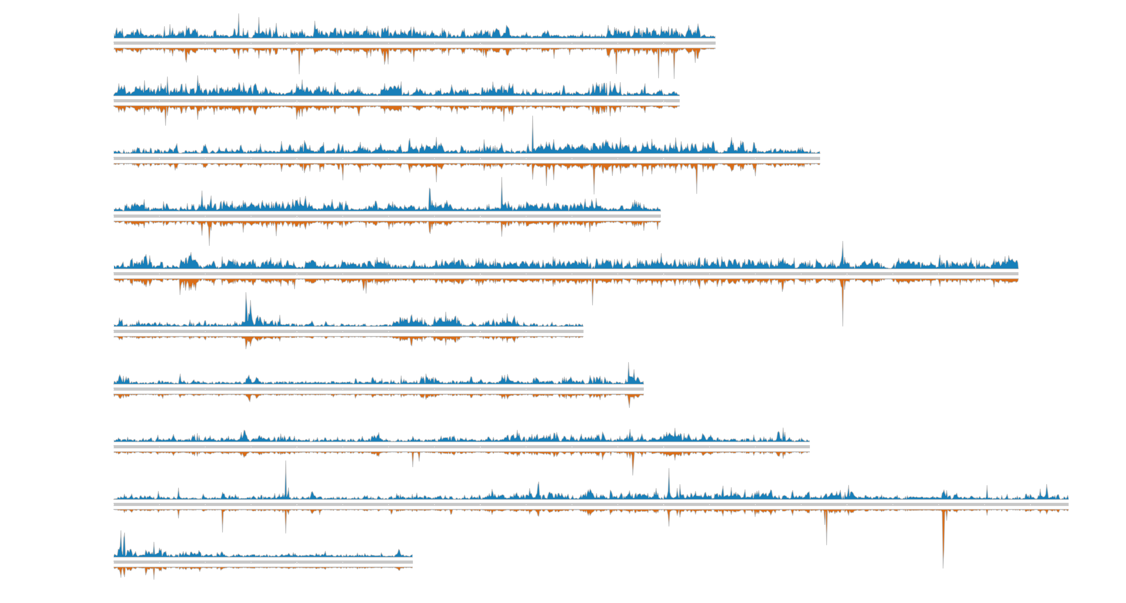
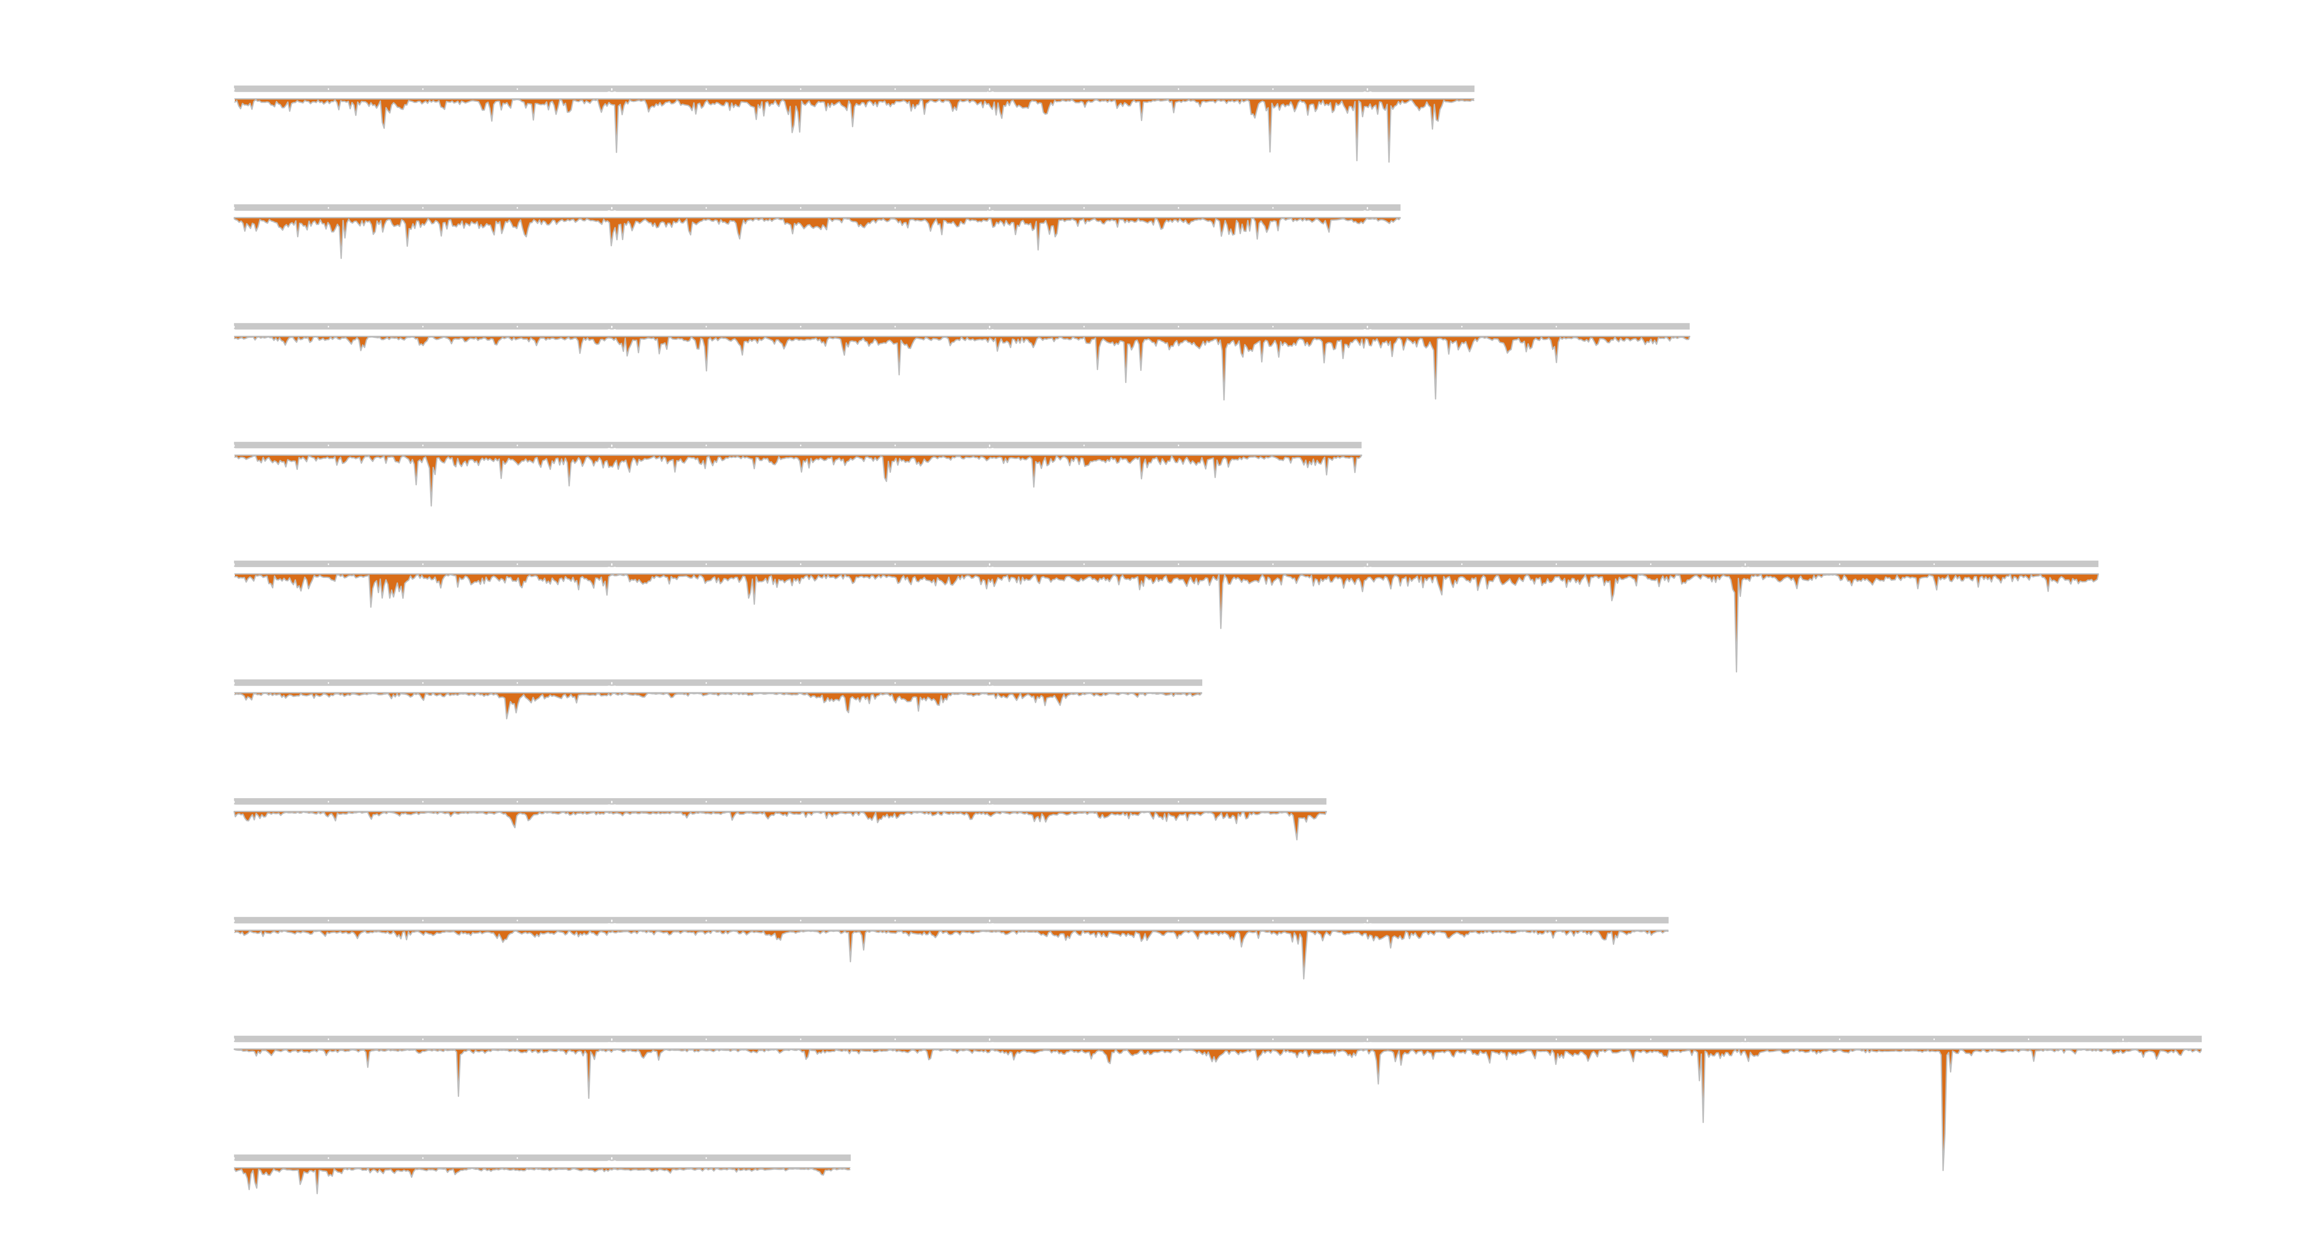

EecSeq targets expressed exons

Slide 43


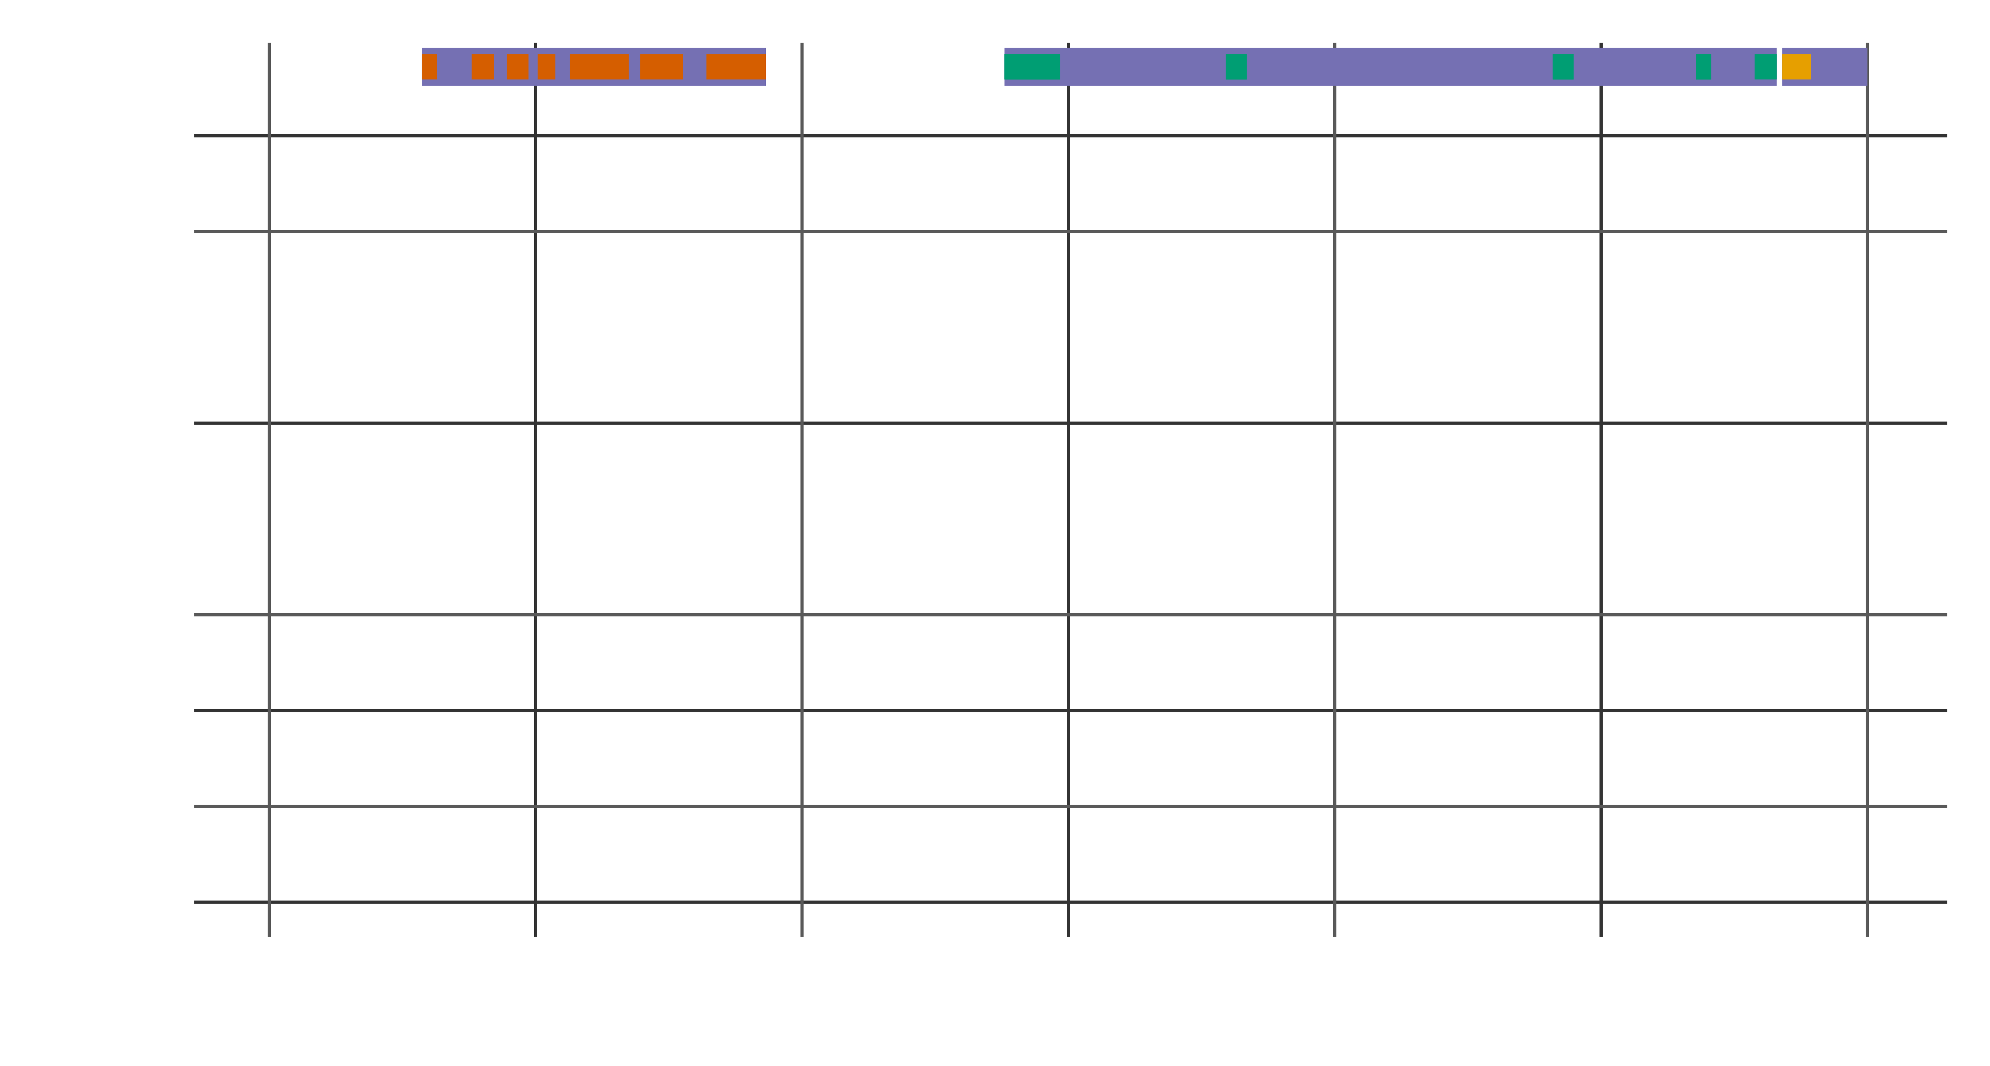
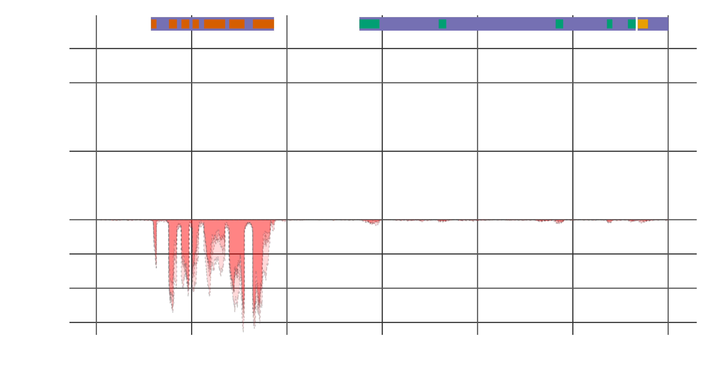

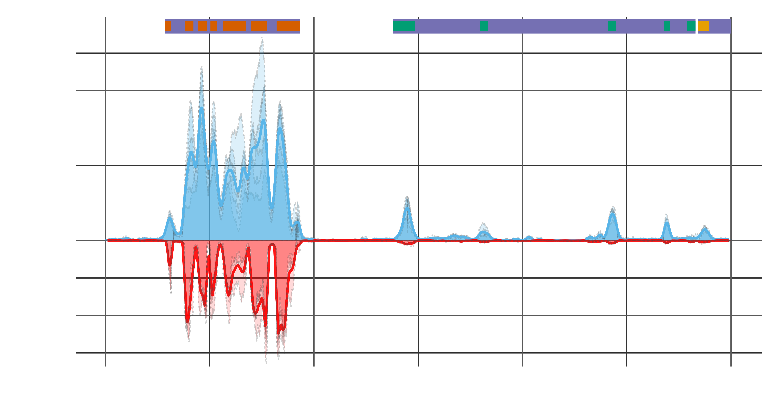
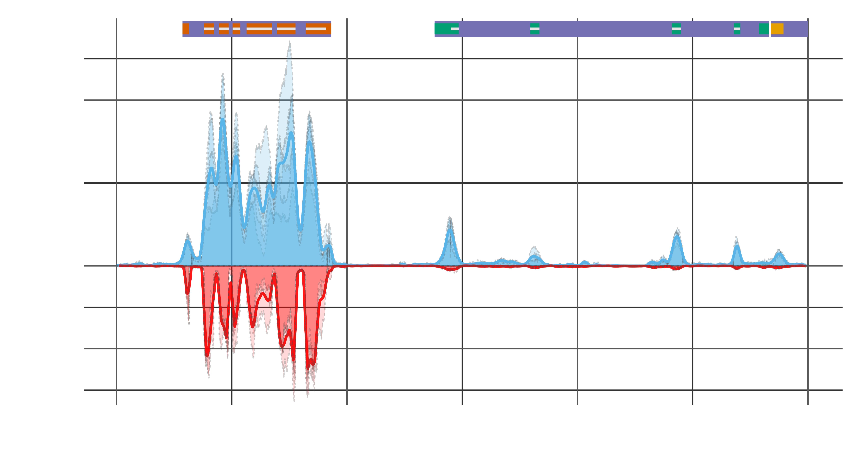
EecSeq targets expressed exons

Slide 44
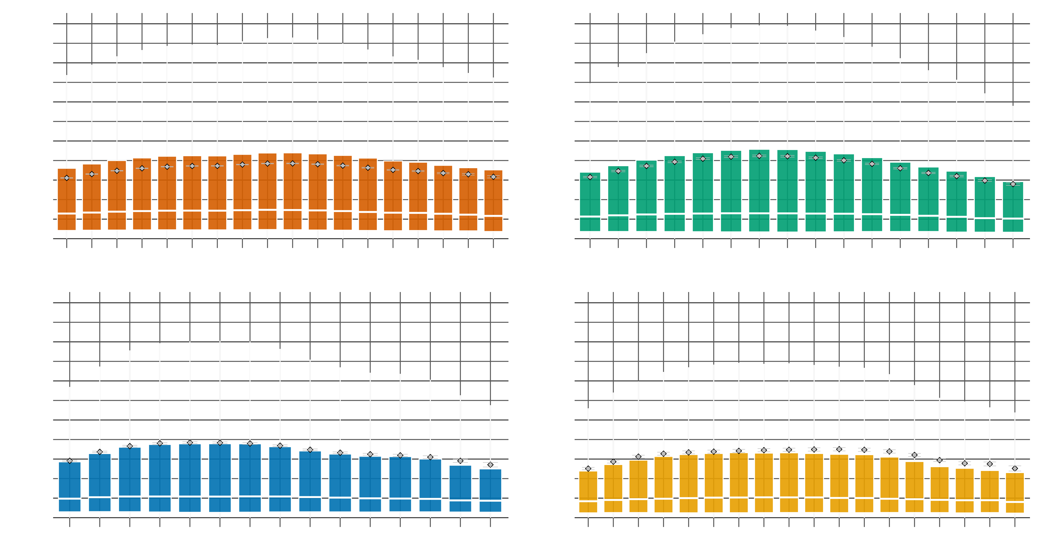
Edge Effects?

Slide 45
Edge Effects?

Slide 46
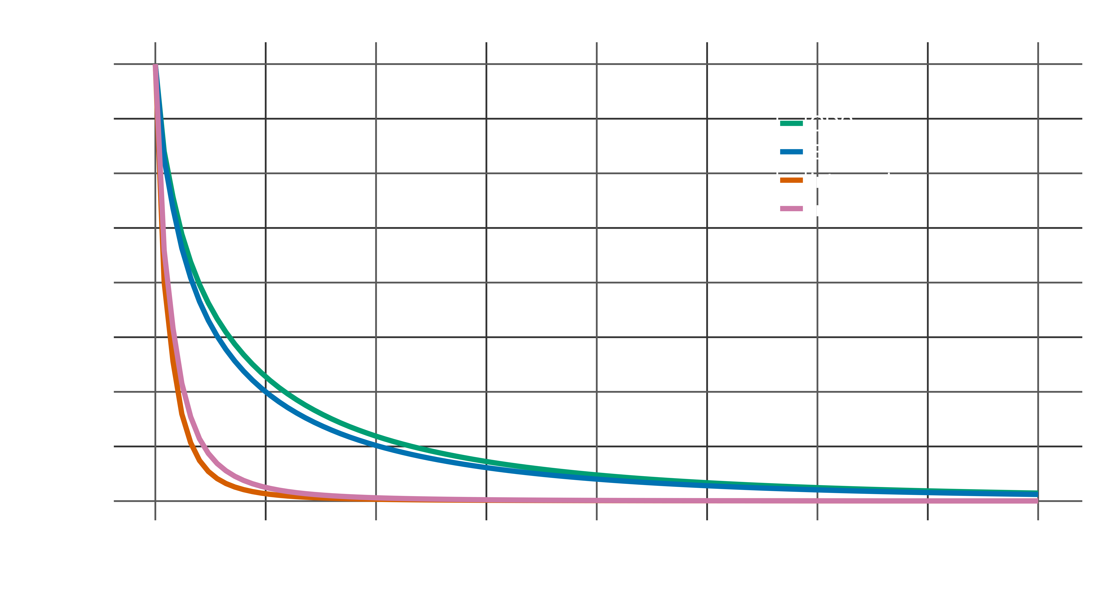
EecSeq Efficiency?

Slide 47
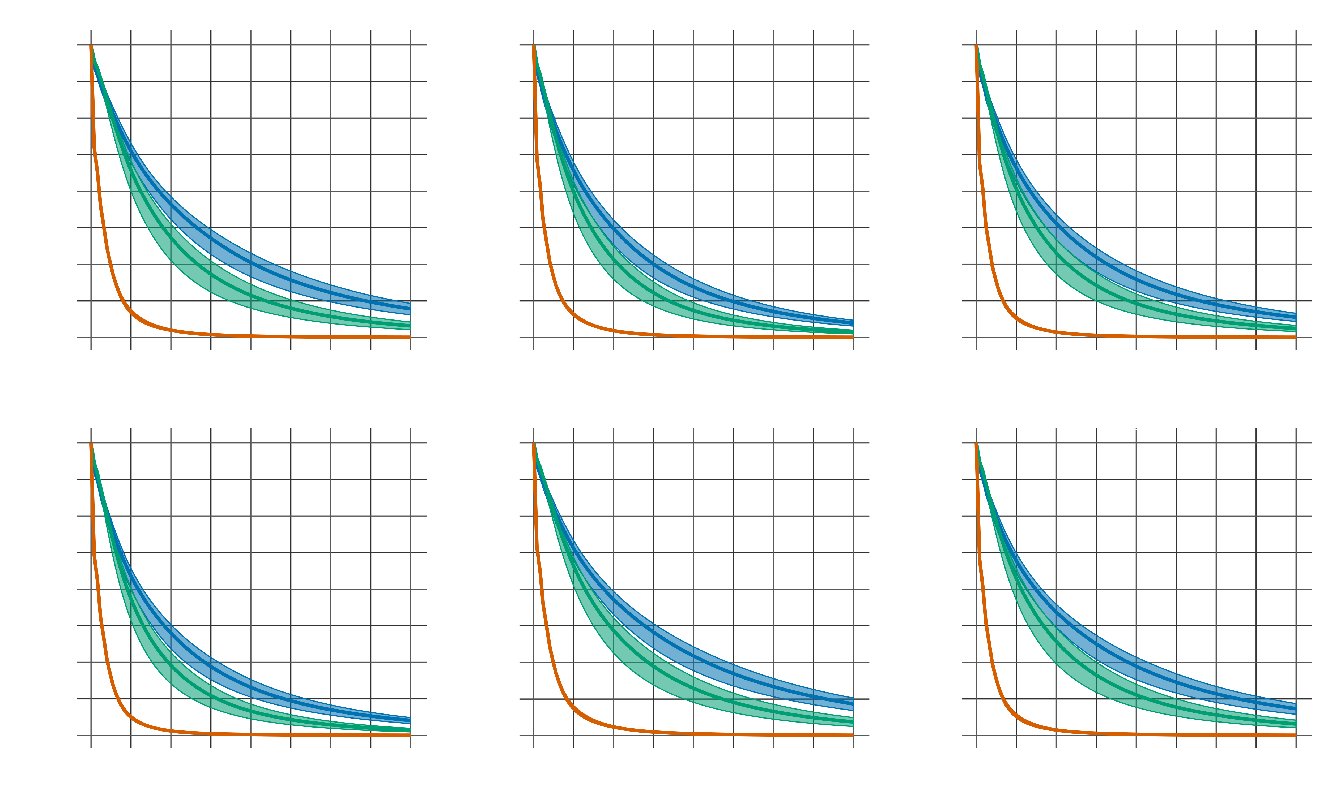
EecSeq capture efficiency

Slide 48
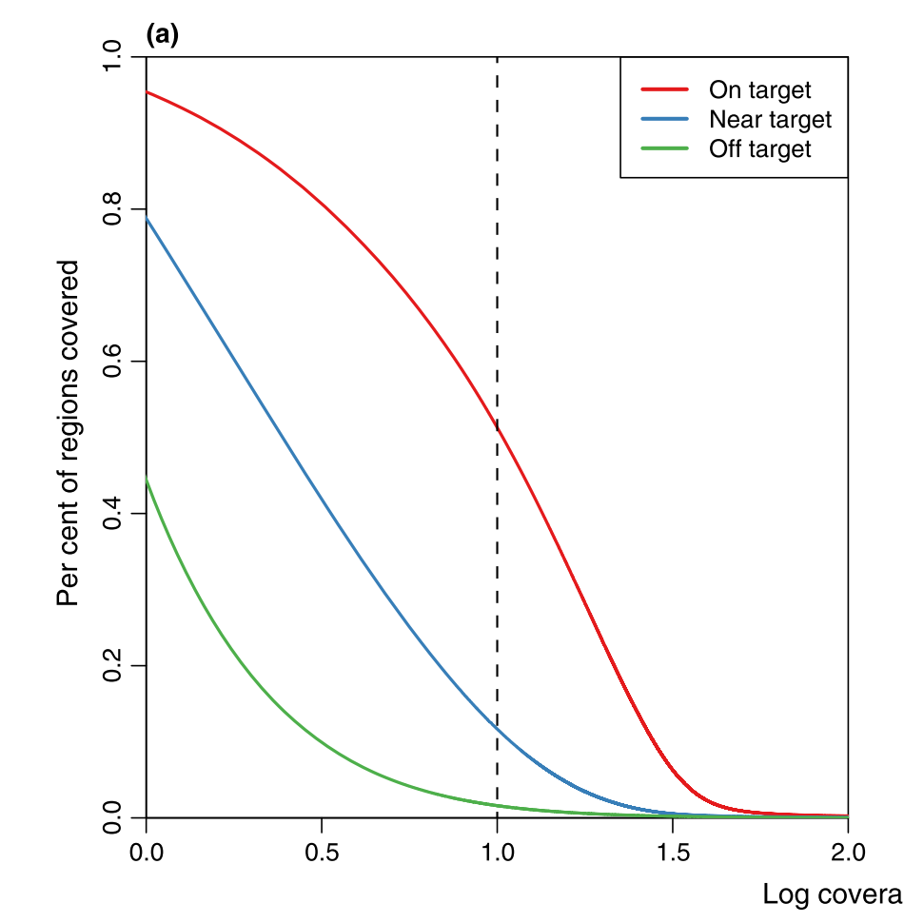
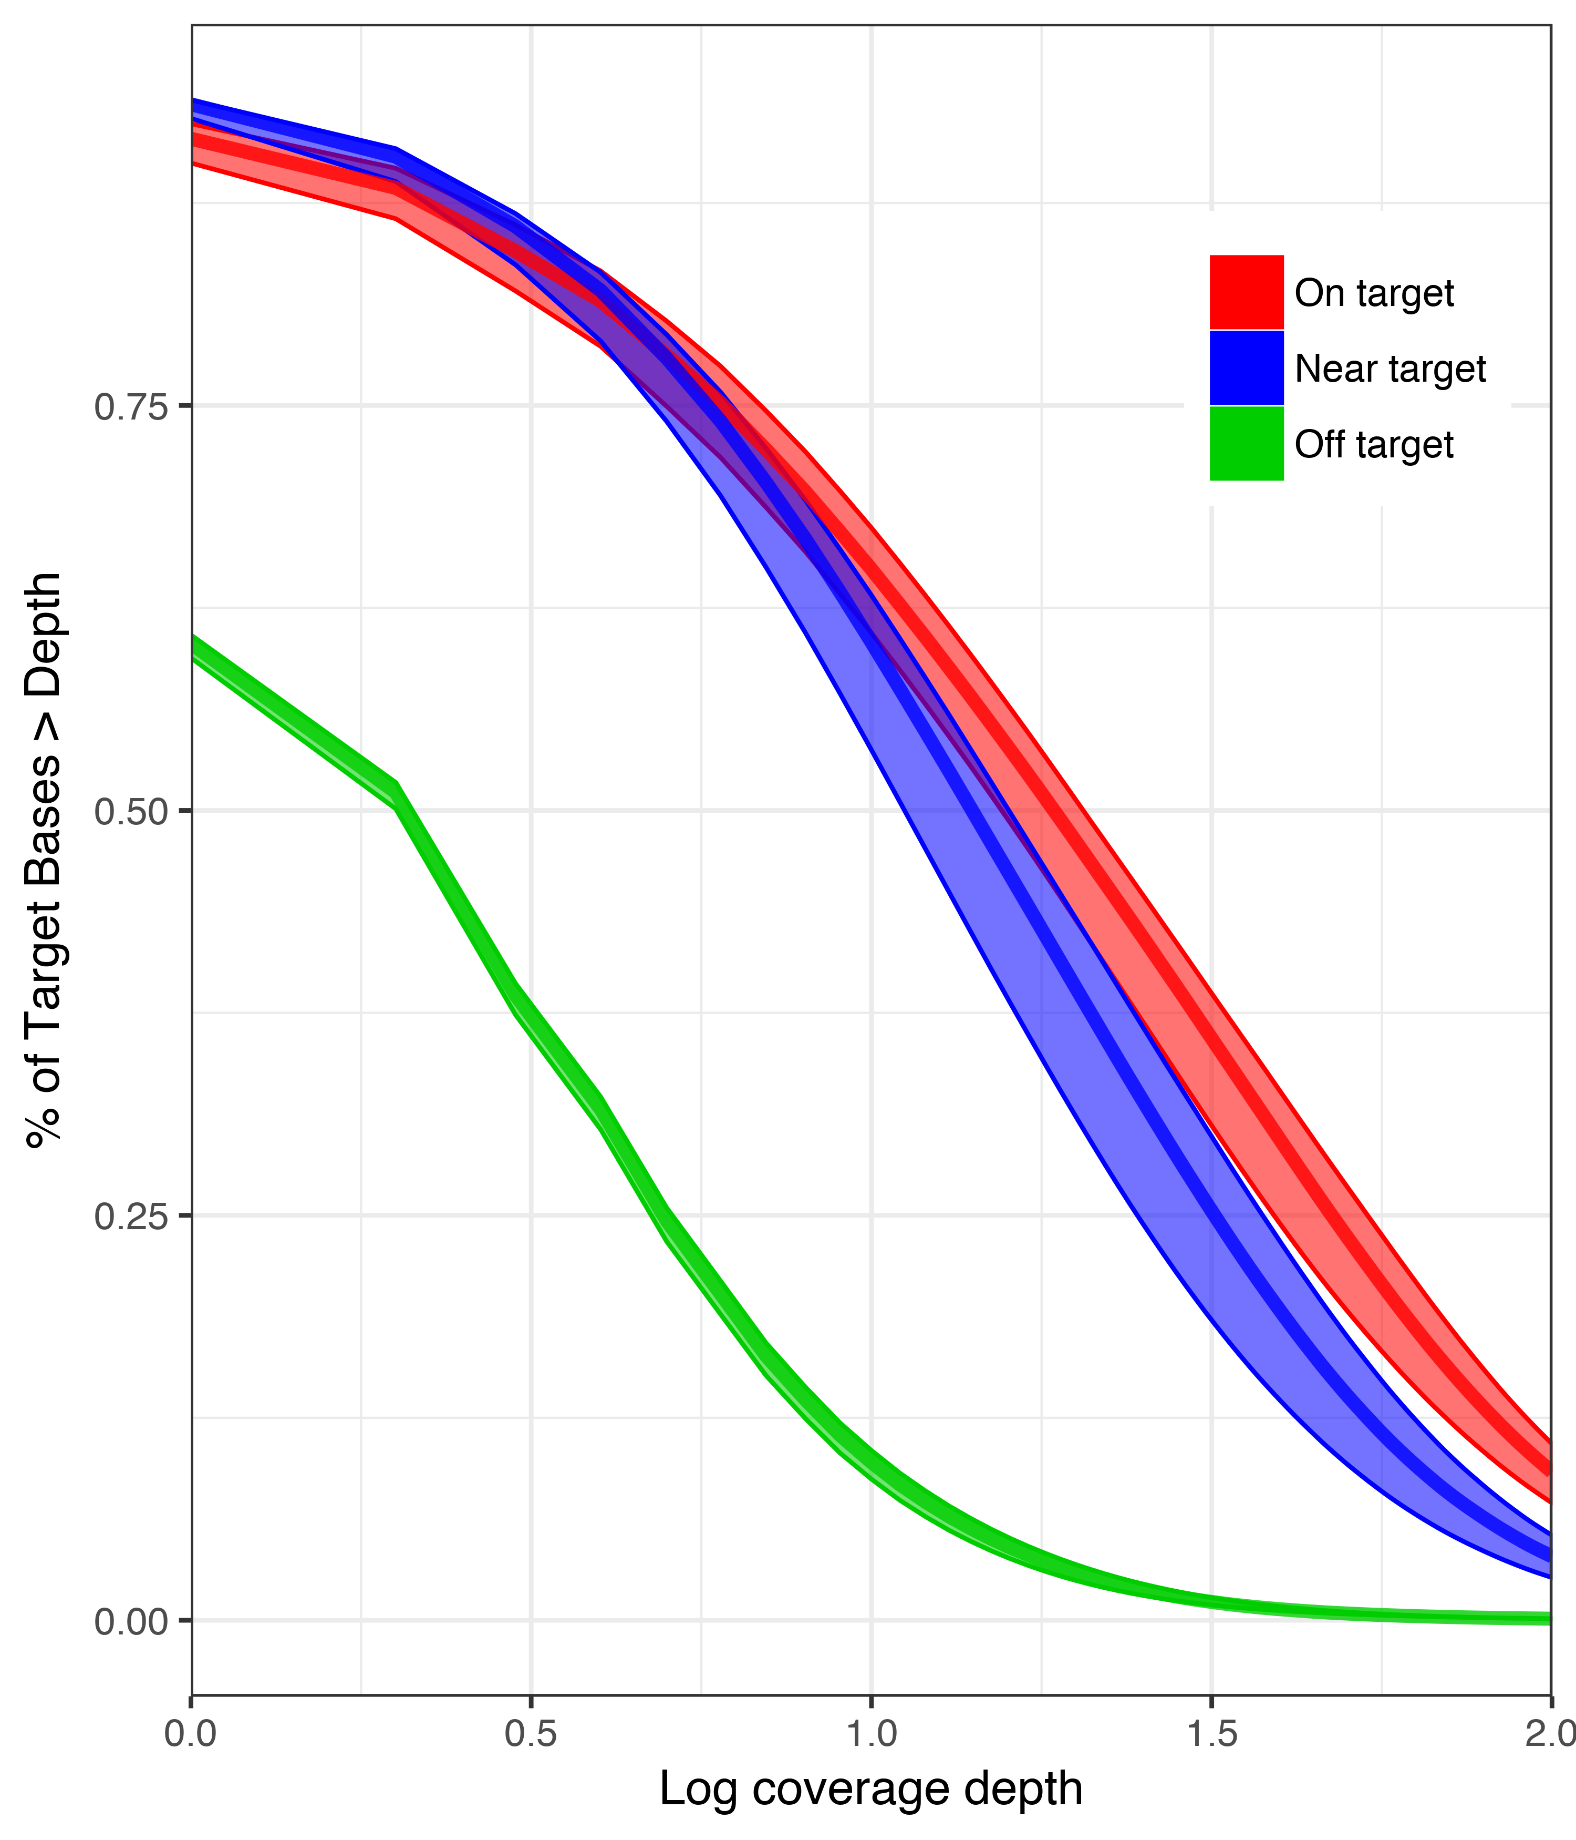
How does EecSeq compare?
Genome/Transcriptome derived
EecSeq
Log coverage depth
Suren et al. 2016

Slide 49
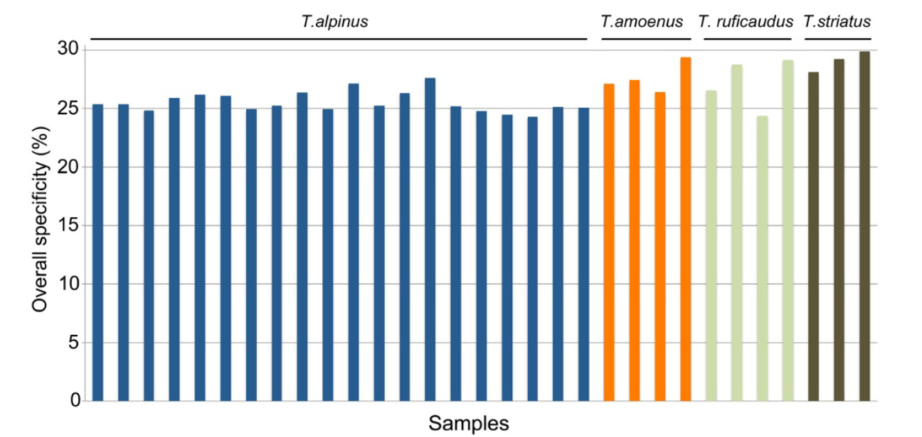
How does EecSeq Compare?
Transcriptome derived
EecSeq
Bi et al. 2012

Slide 50
Take home messages
Expressed exome capture sequencing (EecSeq):
Targets expressed exons
Delivers consistent and efficient exome enrichment
Is comparable to traditional methods of exome capture
Generates thousands of exome SNPs cost effectively

Slide 51
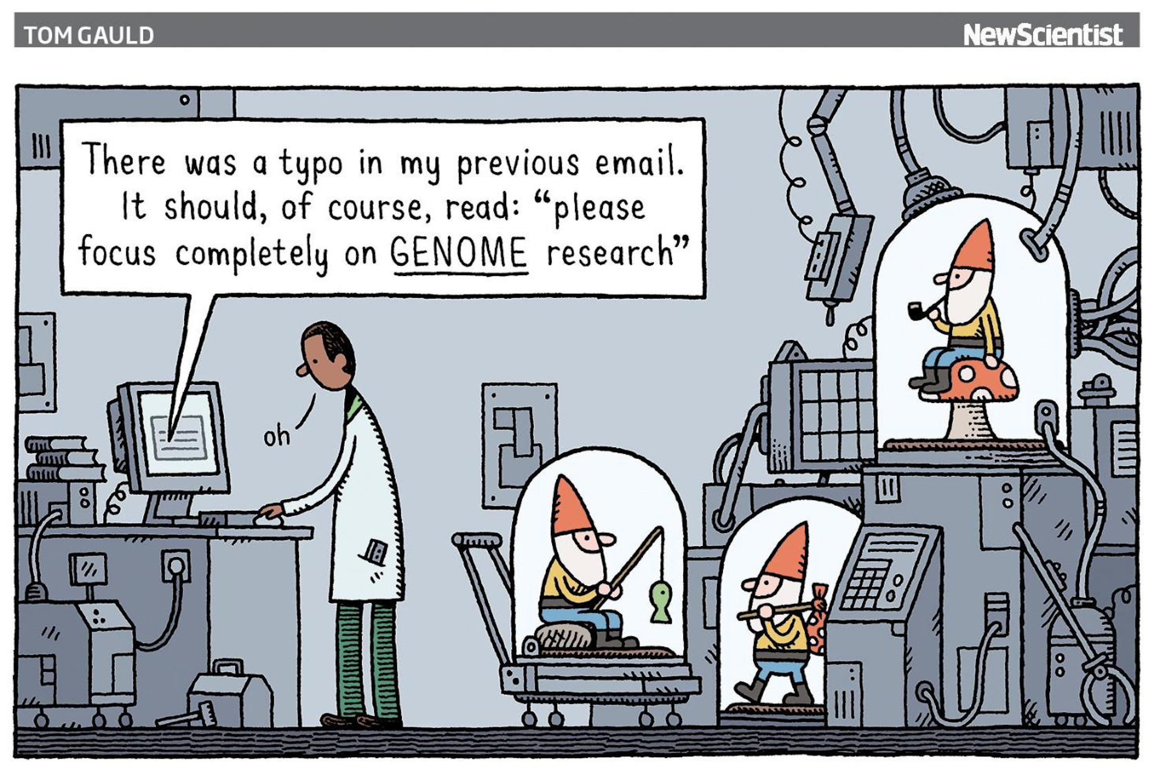
Population genomics without genome reduction
Forget individuals
Estimate allele frequencies from populations directly
PoolSeq
Forget genotypes
Drastically reduce the coverage per individual and work directly with genotype likelihoods
lcWGS
BIO 594

Slide 52
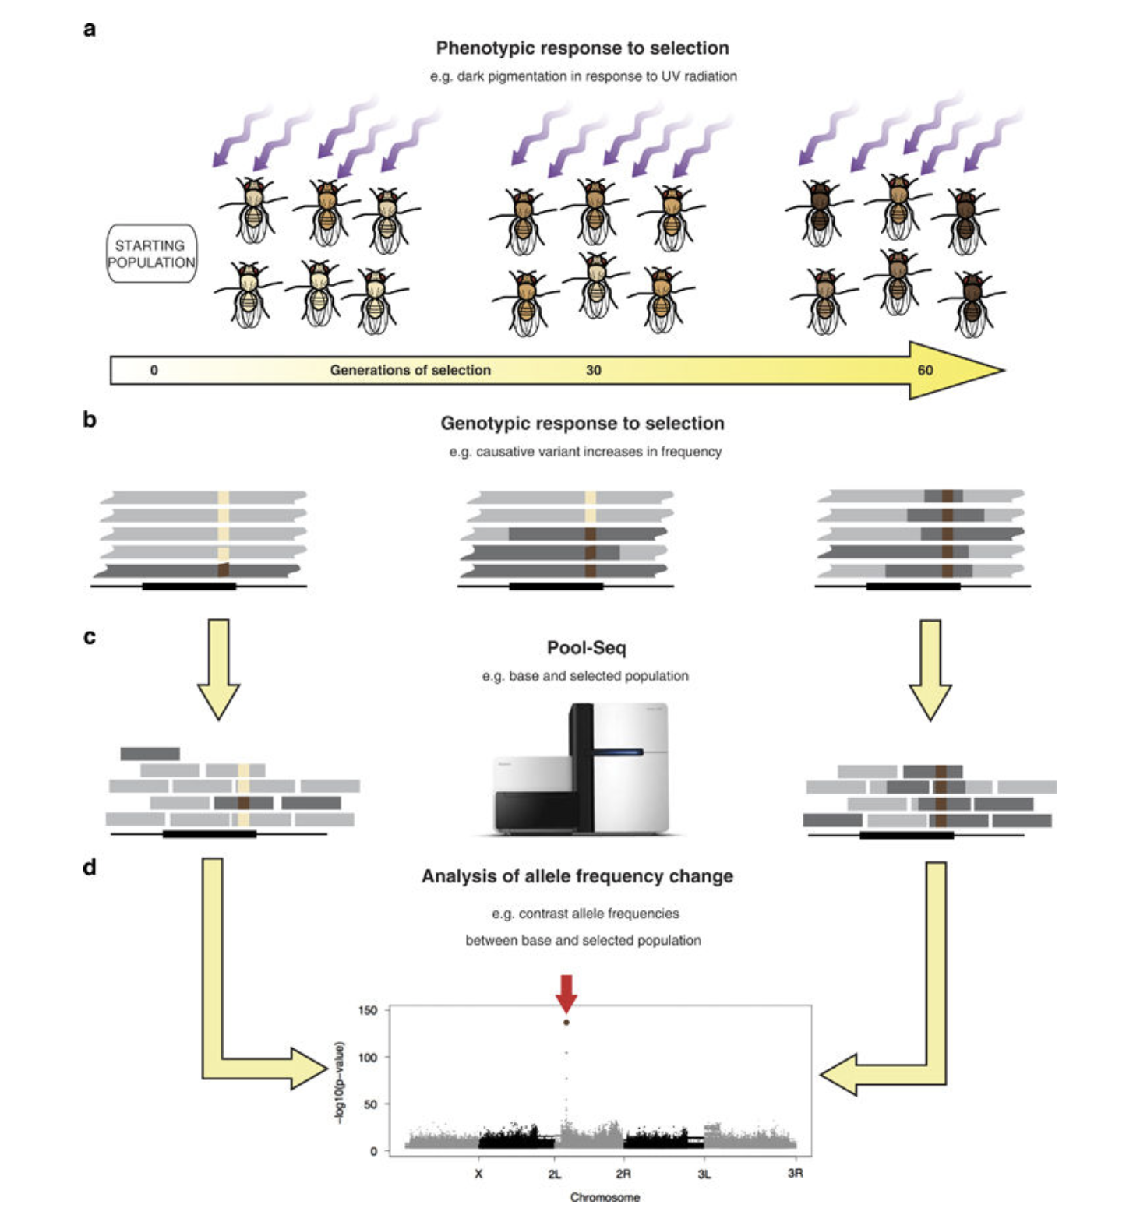
Pooled Sequencing
PoolSeq
DNA/RNA are equimollarly pooled within a population/treatment
Read counts are directly used or placed into a model to estimate the allele frequency of the pool
BIO 594

Slide 53
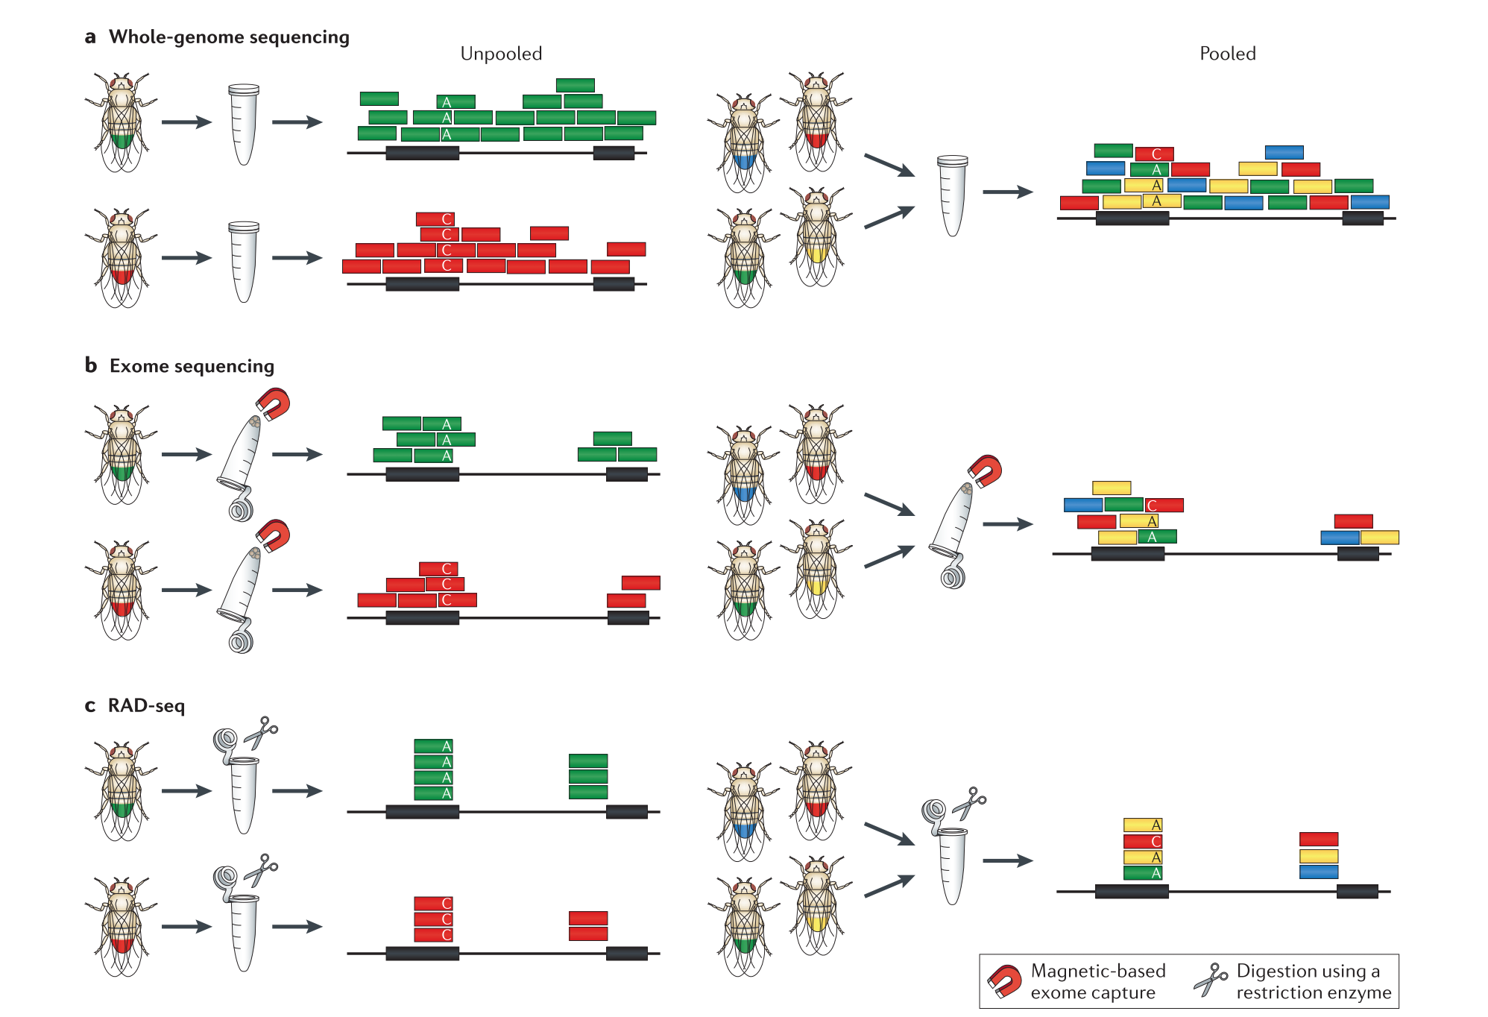
PoolSeq
BIO 594

Slide 54
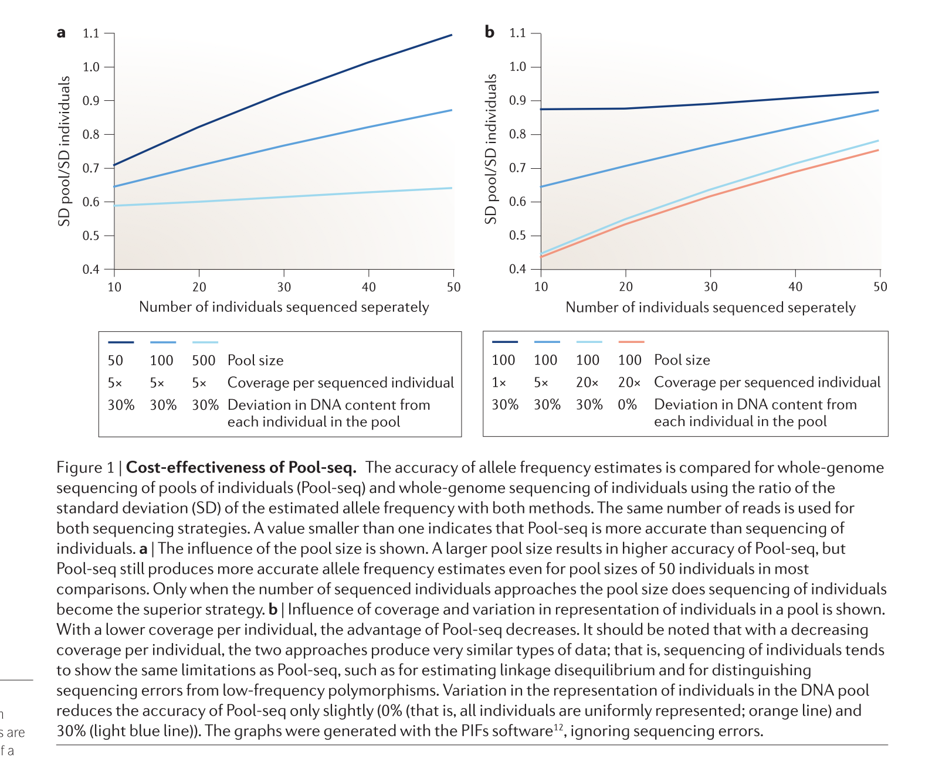
PoolSeq
BIO 594

Slide 55
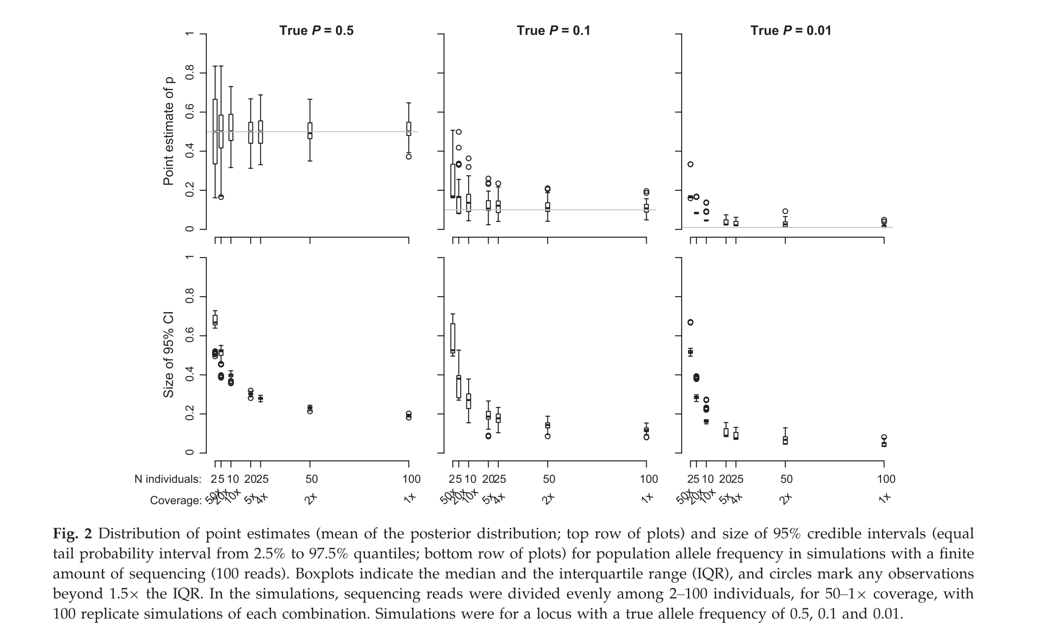
PoolSeq- how low should we go?
BIO 594

Slide 56
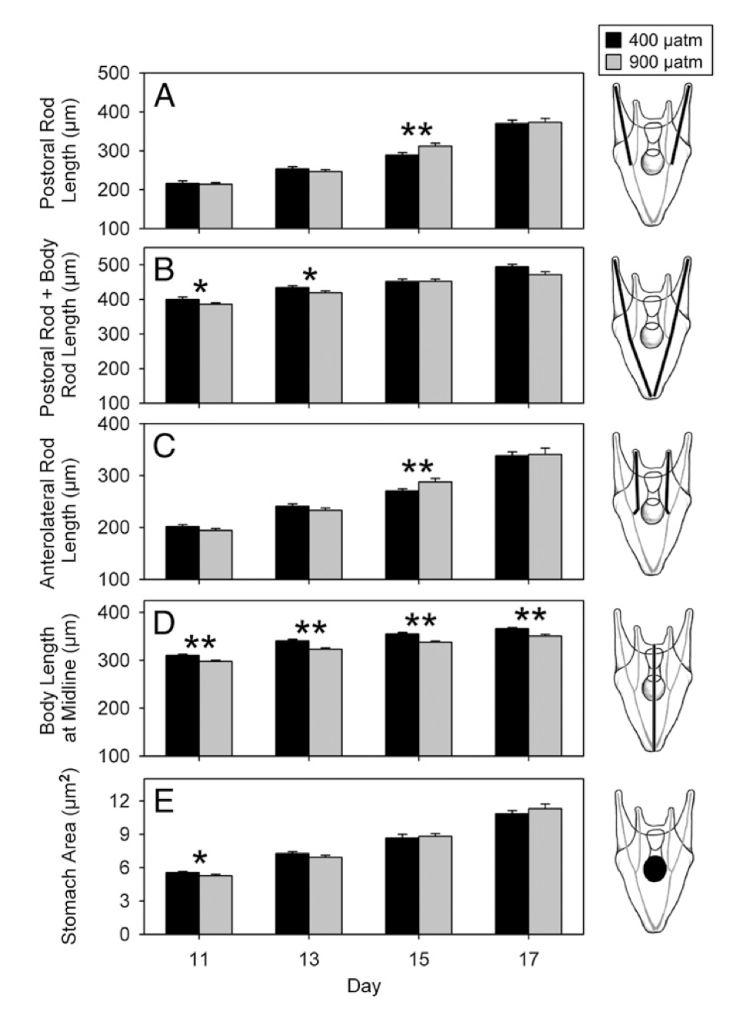
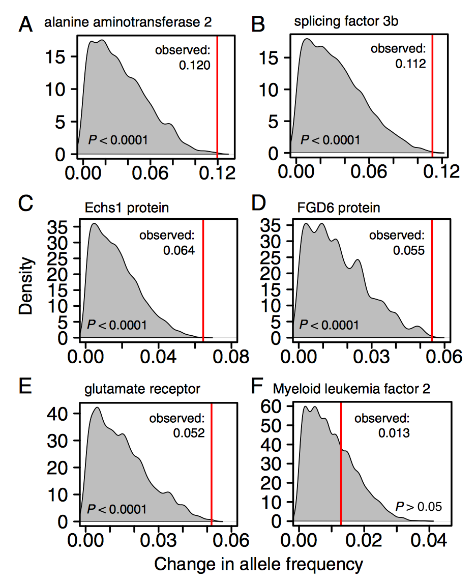
PoolSeq for RNA???????
BIO 594

Slide 57
Low Coverage Whole Genome Sequencing
For this, I am stealing slides from Anders Albrechtsen, one of the authors of ANGSD and expert in this topic
His website can be found: (http://www.popgen.dk/groupWiki/index.php/Anders_Albrechtsen)
BIO 594

Slide 58
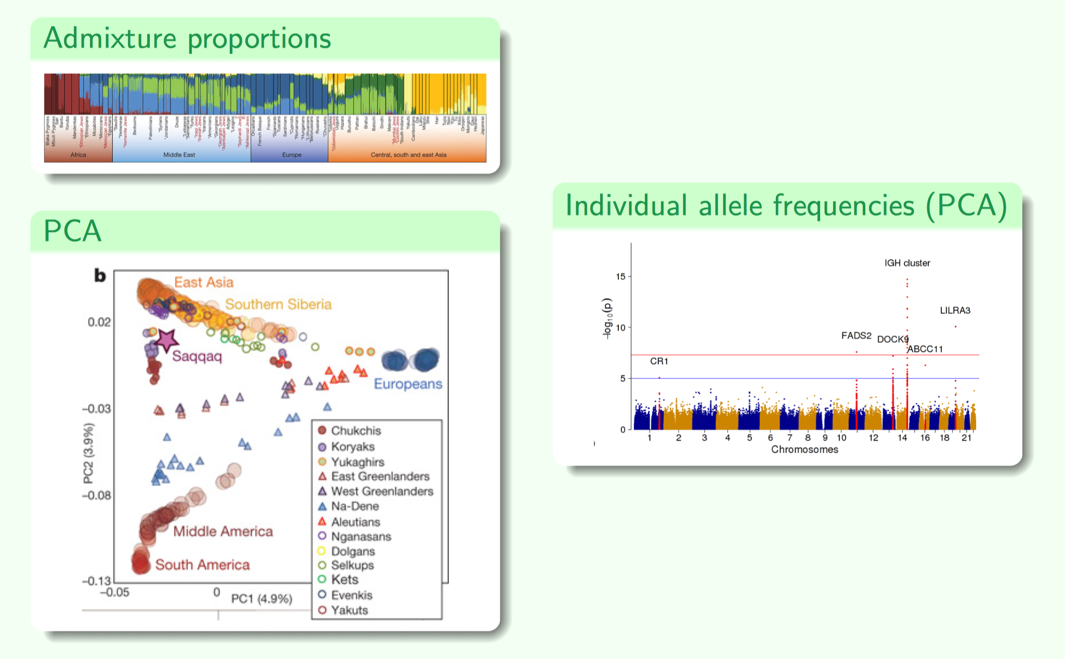
Population genomics with lcWGS
BIO 594

Slide 59
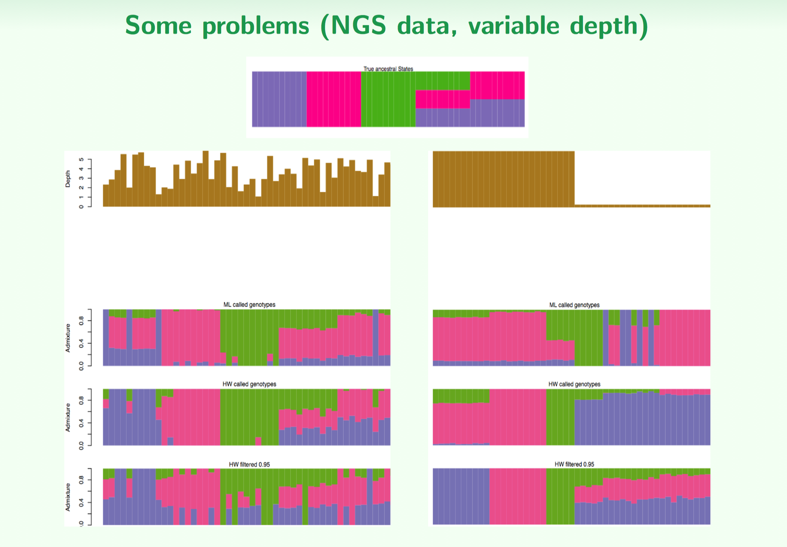
Population genomics with lcWGS
BIO 594

Slide 60
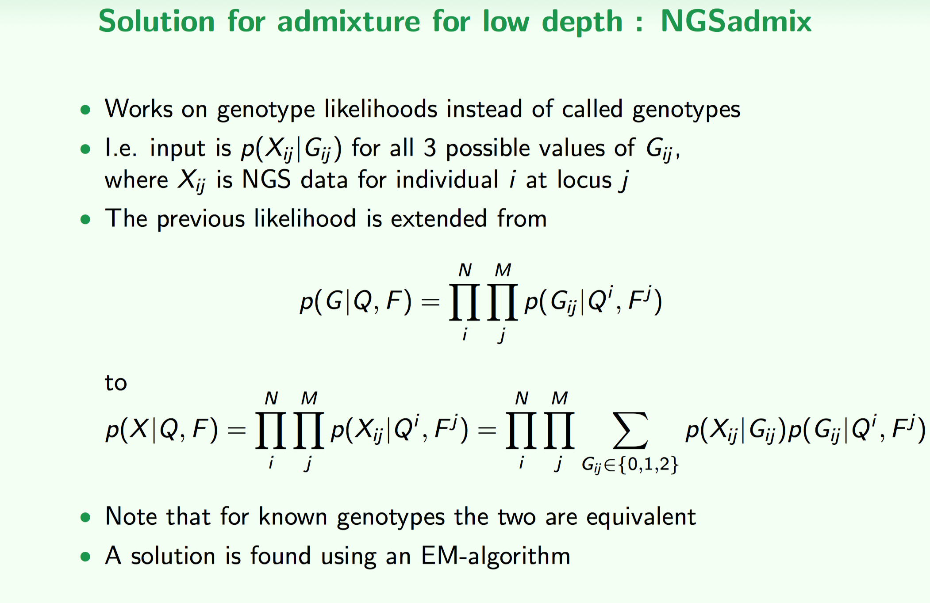
Population genomics with lcWGS
BIO 594

Slide 61
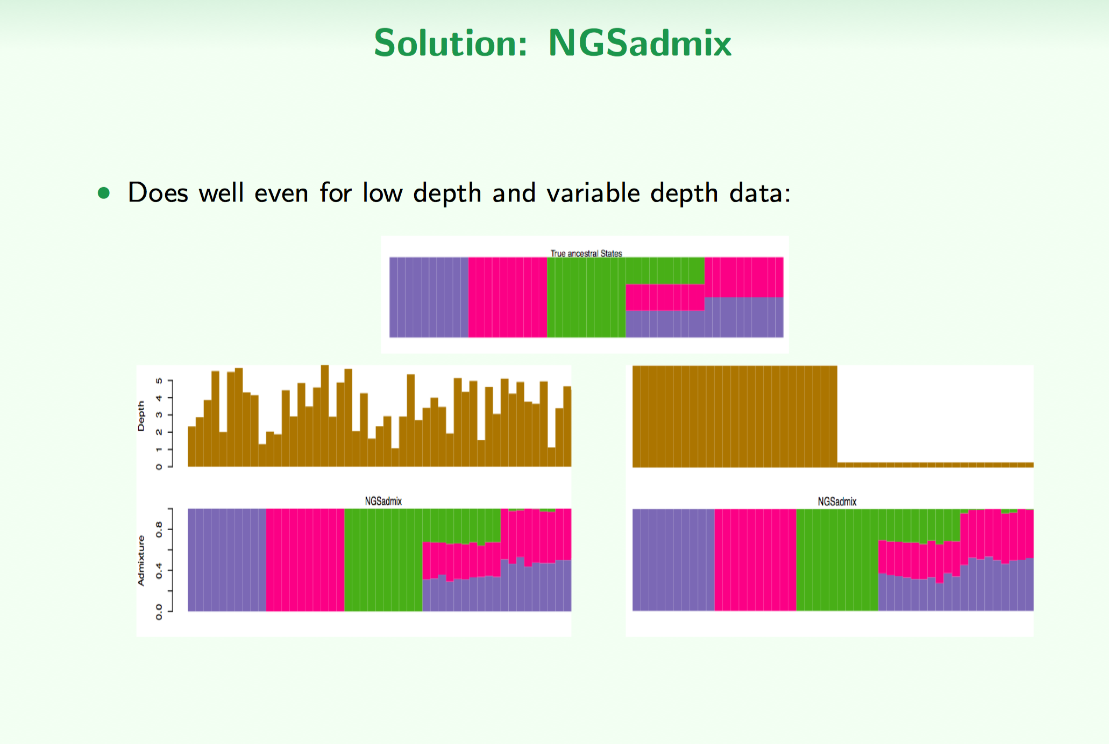
Population genomics with lcWGS
BIO 594

Slide 62
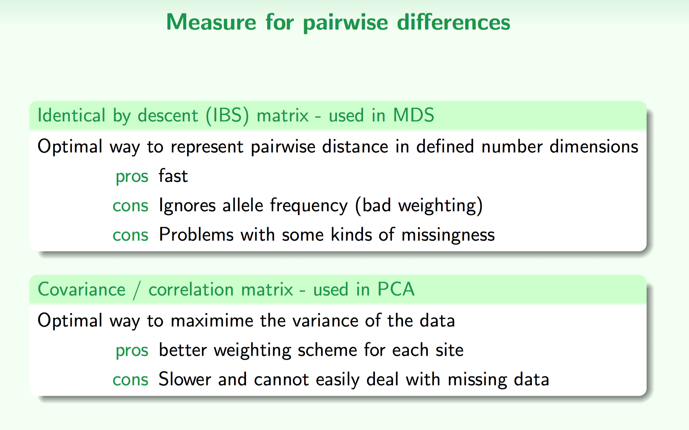
Population genomics with lcWGS: PCA
BIO 594

Slide 63
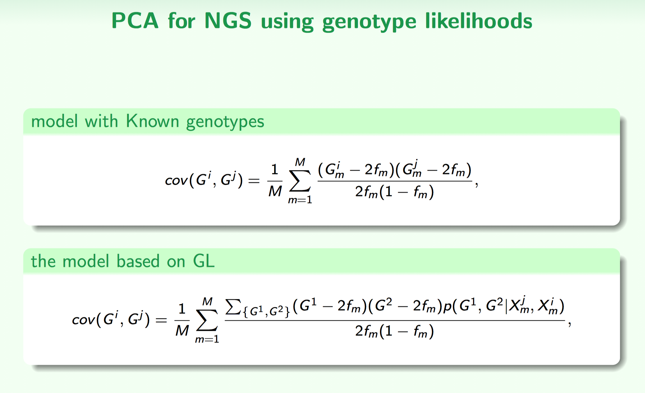
Population genomics with lcWGS: PCA
BIO 594

Slide 64
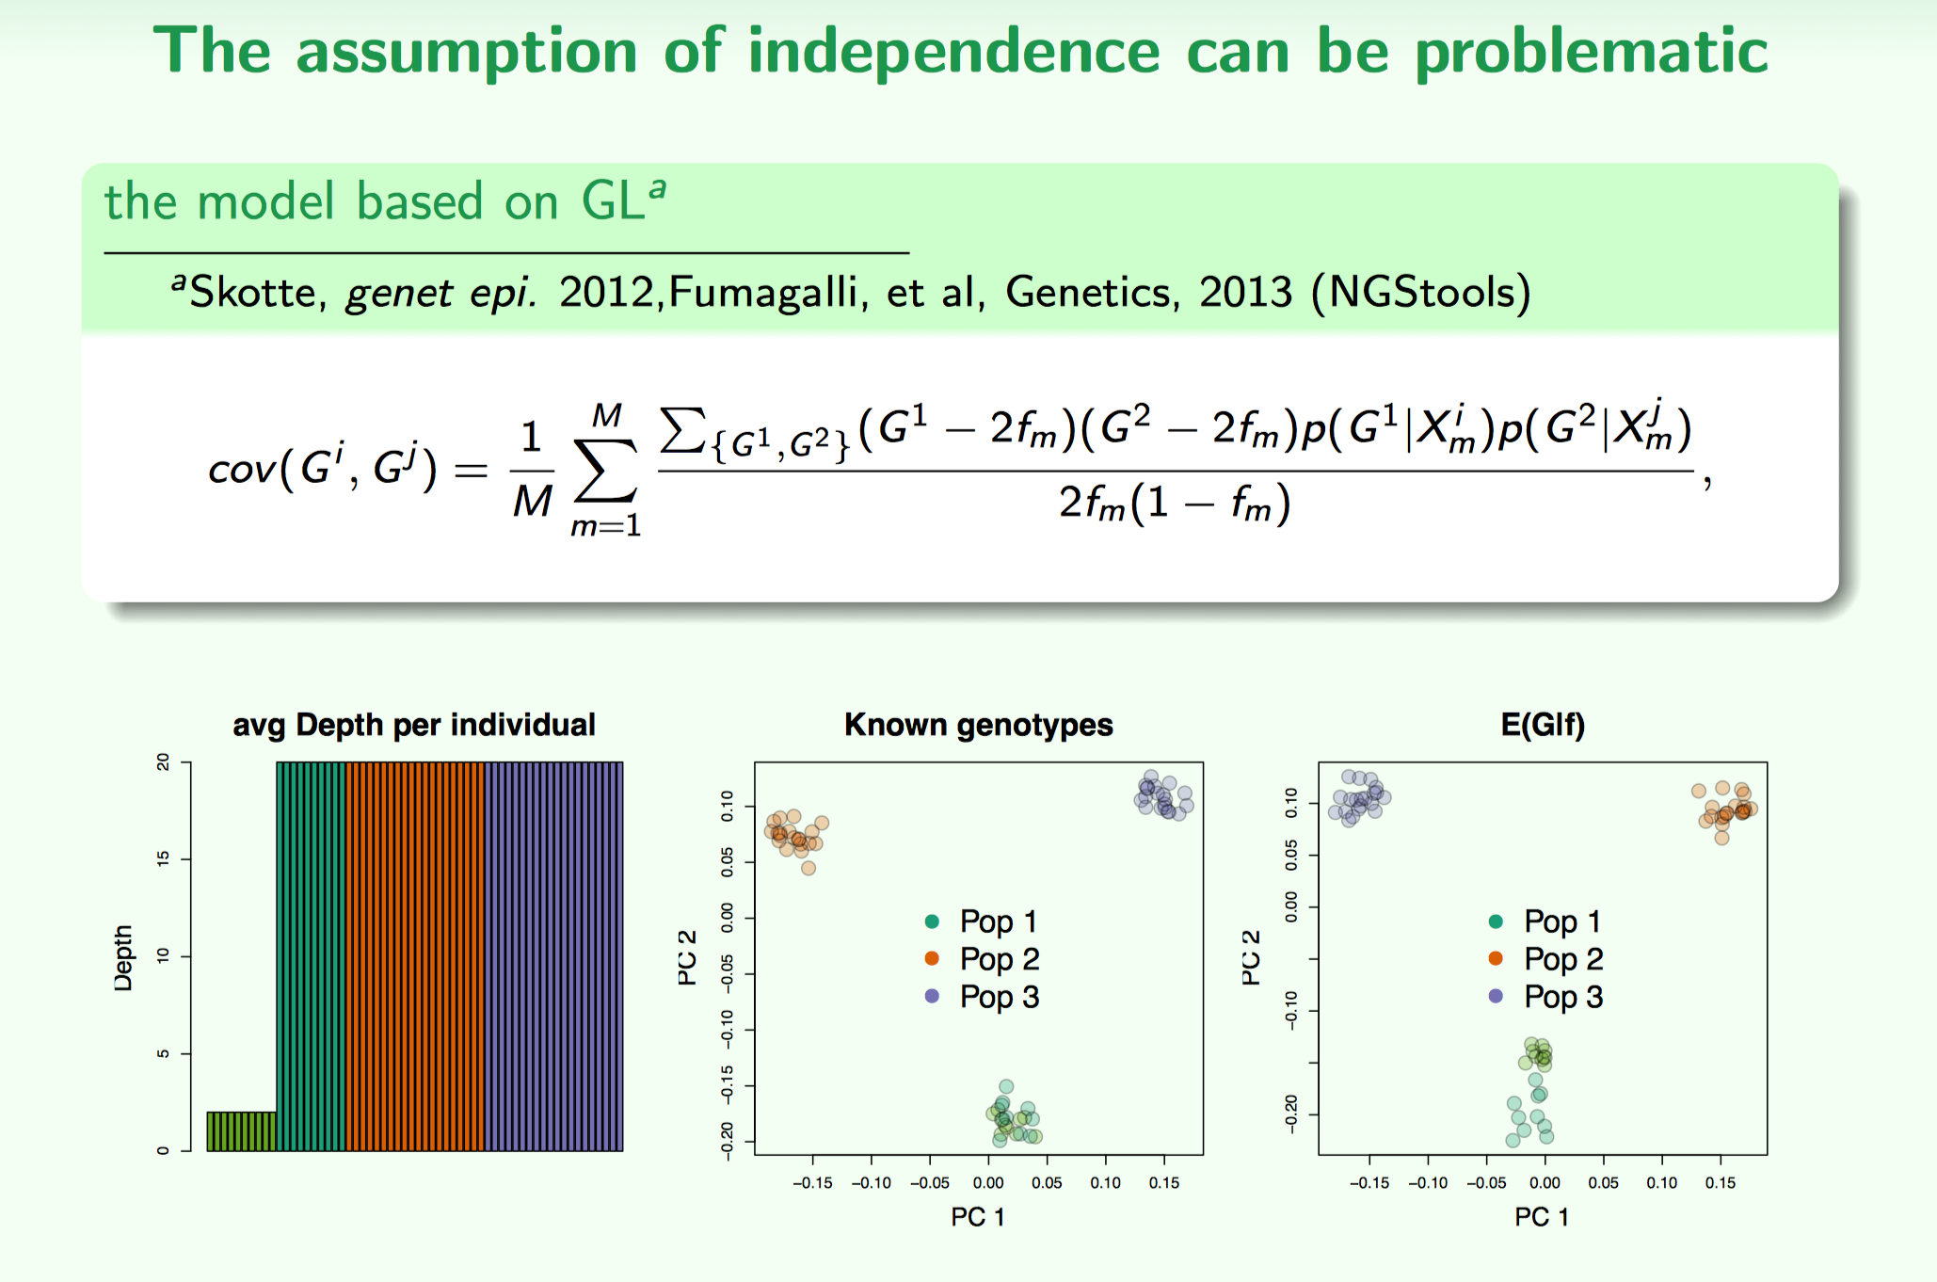
Population genomics with lcWGS: PCA
BIO 594

Slide 65
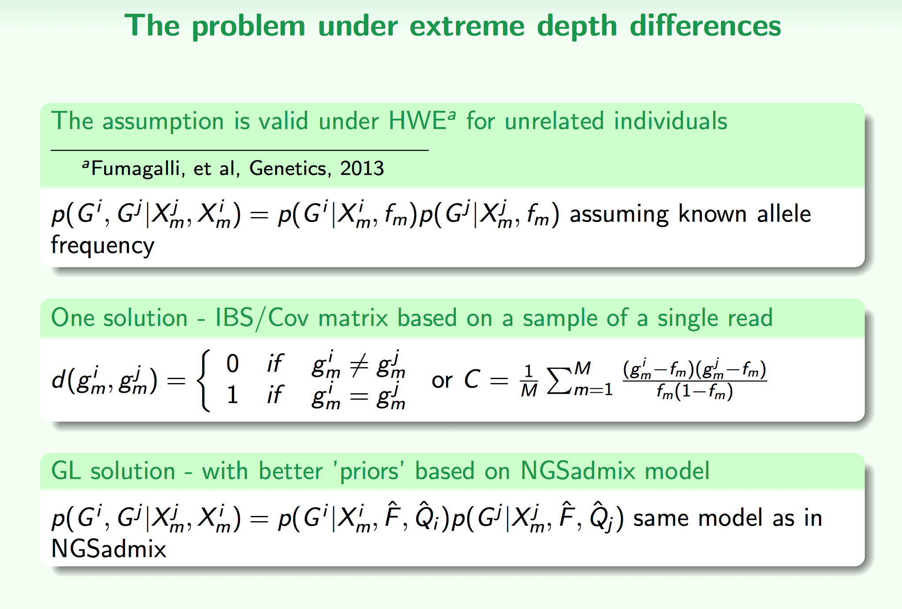
Population genomics with lcWGS: PCA
BIO 594

Slide 66
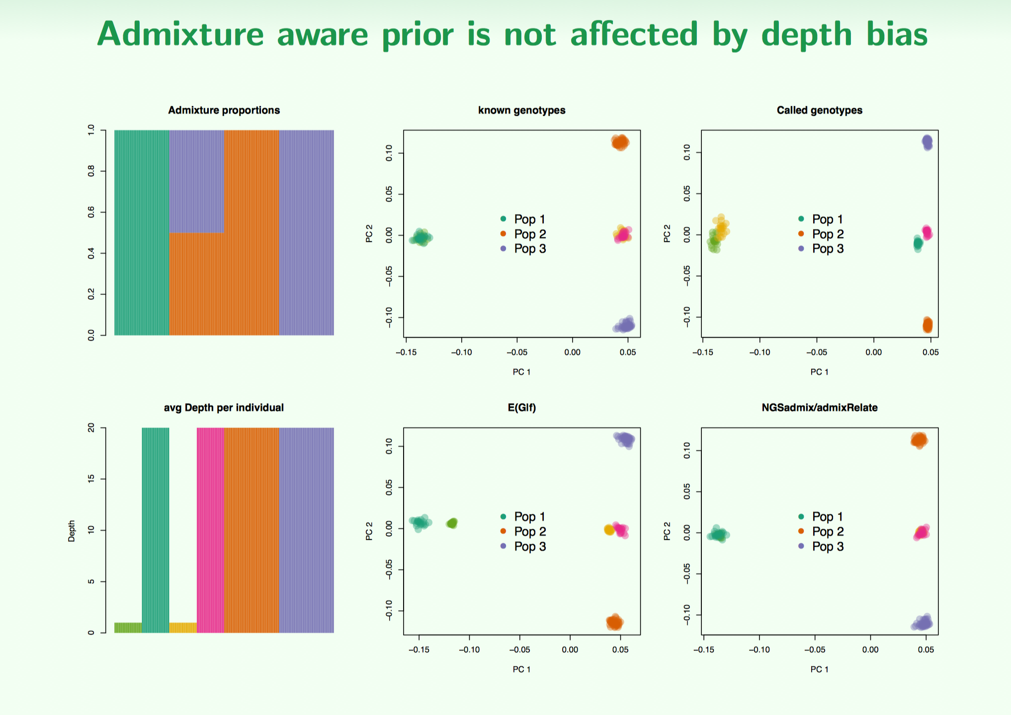
Population genomics with lcWGS: PCA
BIO 594

Slide 67
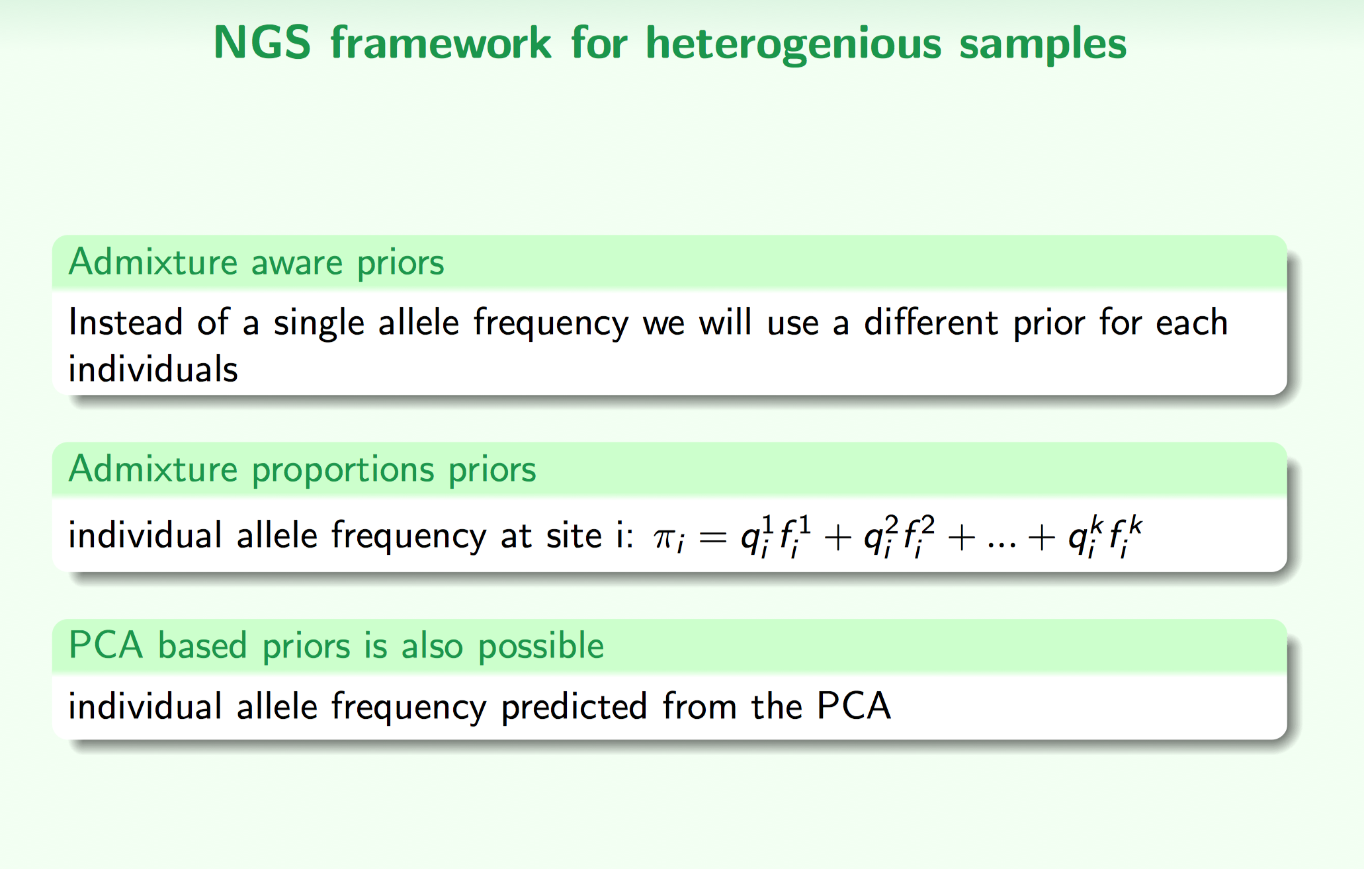
Population genomics with lcWGS: PCA
BIO 594

Slide 68

Population genomics with lcWGS: PCA
BIO 594

Slide 69

Population genomics with lcWGS: PCA
BIO 594

Slide 70

Population genomics with lcWGS: PCA
BIO 594

Slide 71



Population genomics with lcWGS: PCA
BIO 594

Slide 72

Population genomics with lcWGS: PCA
BIO 594

Slide 73

Population genomics with lcWGS: PCA
BIO 594

Slide 74
Population genomics with lcWGS: PCA
BIO 594

Slide 75
Exercises
Exercises
Explore some exome capture data
EecSeq
PCA with low coverage whole genome sequencing
PCangsd
On repository /Exercises/Week10/lcWGS.PCA.md

Slide 76
lcWGS: remove genotypes from the equation
AATTCACCTCGGGTATCTTCAGGAAAACGGTCAAAATCAGGTTTCACAGTATATTGGACTCCTC
AATTCACCTCGGGTATCTTCAGGAAAACGGTCAAAATCAGGTTTCACAGTATATTGGACTCCTC
AATTCACCTCGGGTATCTTCAGGAAAACGGTCAAAATCAGGTTTCACAGTATATTGGACTCCTC
AATTCACCTCGGGTATCTTCAGGAAAACGGTCAAAATCAGGTTTCACAGTATATTGGACTCCTC
AATTCACCTCGGGTATCTTCAGGAAAACGGTCAAAATCAGGTTTCACAGTATATTGGACTCCTC
AATTCACCTCGGGTATCTTCAGGAAAACAGTCAAAATCAGGTTTCACAGTATATTGGACTCCTC
AATTCACCTCGGGTATCTTCAGGAAAACAGTCAAAATCAGGTTTCACAGTATATTGGACTCCTC
AATTCACCTCGGGTATCTTCAGGAAAACAGTCAAAATCAGGTTTCACAGTATATTGGACTCCTC
AATTCACCTCGGGTATCTTCAGGAAAACAGTCAAAATCAGGTTTCACAGTATATTGGACTCCTC
AATTCACCTCGGGTATCTTCAGGAAAACAGTCAAAATCAGGTTTCACAGTATATTGGACTCCTC
BIO 594

Slide 77
lcWGS: remove genotypes from the equation
AATTCACCTCGGGTATCTTCAGGAAAACGGTCAAAATCAGGTTTCACAGTATATTGGACTCCTC
AATTCACCTCGGGTATCTTCAGGAAAACGGTCAAAATCAGGTTTCACAGTATATTGGACTCCTC
AATTCACCTCGGGTATCTTCAGGAAAACGGTCAAAATCAGGTTTCACAGTATATTGGACTCCTC
AATTCACCTCGGGTATCTTCAGGAAAACGGTCAAAATCAGGTTTCACAGTATATTGGACTCCTC
AATTCACCTCGGGTATCTTCAGGAAAACGGTCAAAATCAGGTTTCACAGTATATTGGACTCCTC
AATTCACCTCGGGTATCTTCAGGAAAACAGTCAAAATCAGGTTTCACAGTATATTGGACTCCTC
AATTCACCTCGGGTATCTTCAGGAAAACAGTCAAAATCAGGTTTCACAGTATATTGGACTCCTC
AATTCACCTCGGGTATCTTCAGGAAAACAGTCAAAATCAGGTTTCACAGTATATTGGACTCCTC
AATTCACCTCGGGTATCTTCAGGAAAACAGTCAAAATCAGGTTTCACAGTATATTGGACTCCTC
AATTCACCTCGGGTATCTTCAGGAAAACAGTCAAAATCAGGTTTCACAGTATATTGGACTCCTC
Likelihood of this individual being a G/A heterozygote?
Likelihood of this individual being a G/G homozygote?
Likelihood of this individual being a A/A homozygote?
BIO 594

Slide 78
lcWGS: remove genotypes from the equation
AATTCACCTCGGGTATCTTCAGGAAAACGGTCAAAATCAGGTTTCACAGTATATTGGACTCCTC
AATTCACCTCGGGTATCTTCAGGAAAACGGTCAAAATCAGGTTTCACAGTATATTGGACTCCTC
AATTCACCTCGGGTATCTTCAGGAAAACGGTCAAAATCAGGTTTCACAGTATATTGGACTCCTC
AATTCACCTCGGGTATCTTCAGGAAAACGGTCAAAATCAGGTTTCACAGTATATTGGACTCCTC
AATTCACCTCGGGTATCTTCAGGAAAACGGTCAAAATCAGGTTTCACAGTATATTGGACTCCTC
AATTCACCTCGGGTATCTTCAGGAAAACGGTCAAAATCAGGTTTCACAGTATATTGGACTCCTC
AATTCACCTCGGGTATCTTCAGGAAAACGGTCAAAATCAGGTTTCACAGTATATTGGACTCCTC
AATTCACCTCGGGTATCTTCAGGAAAACGGTCAAAATCAGGTTTCACAGTATATTGGACTCCTC
AATTCACCTCGGGTATCTTCAGGAAAACGGTCAAAATCAGGTTTCACAGTATATTGGACTCCTC
AATTCACCTCGGGTATCTTCAGGAAAACGGTCAAAATCAGGTTTCACAGTATATTGGACTCCTC
Likelihood of this individual being a G/A heterozygote?
Likelihood of this individual being a G/G homozygote?
Likelihood of this individual being a A/A homozygote?
BIO 594

Slide 79
lcWGS: remove genotypes from the equation
AATTCACCTCGGGTATCTTCAGGAAAACAGTCAAAATCAGGTTTCACAGTATATTGGACTCCTC
AATTCACCTCGGGTATCTTCAGGAAAACAGTCAAAATCAGGTTTCACAGTATATTGGACTCCTC
AATTCACCTCGGGTATCTTCAGGAAAACAGTCAAAATCAGGTTTCACAGTATATTGGACTCCTC
AATTCACCTCGGGTATCTTCAGGAAAACAGTCAAAATCAGGTTTCACAGTATATTGGACTCCTC
AATTCACCTCGGGTATCTTCAGGAAAACAGTCAAAATCAGGTTTCACAGTATATTGGACTCCTC
AATTCACCTCGGGTATCTTCAGGAAAACAGTCAAAATCAGGTTTCACAGTATATTGGACTCCTC
AATTCACCTCGGGTATCTTCAGGAAAACAGTCAAAATCAGGTTTCACAGTATATTGGACTCCTC
AATTCACCTCGGGTATCTTCAGGAAAACAGTCAAAATCAGGTTTCACAGTATATTGGACTCCTC
AATTCACCTCGGGTATCTTCAGGAAAACAGTCAAAATCAGGTTTCACAGTATATTGGACTCCTC
AATTCACCTCGGGTATCTTCAGGAAAACAGTCAAAATCAGGTTTCACAGTATATTGGACTCCTC
Likelihood of this individual being a G/A heterozygote?
Likelihood of this individual being a G/G homozygote?
Likelihood of this individual being a A/A homozygote?
BIO 594

Slide 80
lcWGS: remove genotypes from the equation
AATTCACCTCGGGTATCTTCAGGAAAACGGTCAAAATCAGGTTTCACAGTATATTGGACTCCTC
AATTCACCTCGGGTATCTTCAGGAAAACGGTCAAAATCAGGTTTCACAGTATATTGGACTCCTC
AATTCACCTCGGGTATCTTCAGGAAAACGGTCAAAATCAGGTTTCACAGTATATTGGACTCCTC
AATTCACCTCGGGTATCTTCAGGAAAACGGTCAAAATCAGGTTTCACAGTATATTGGACTCCTC
AATTCACCTCGGGTATCTTCAGGAAAACGGTCAAAATCAGGTTTCACAGTATATTGGACTCCTC
AATTCACCTCGGGTATCTTCAGGAAAACGGTCAAAATCAGGTTTCACAGTATATTGGACTCCTC
AATTCACCTCGGGTATCTTCAGGAAAACGGTCAAAATCAGGTTTCACAGTATATTGGACTCCTC
AATTCACCTCGGGTATCTTCAGGAAAACGGTCAAAATCAGGTTTCACAGTATATTGGACTCCTC
AATTCACCTCGGGTATCTTCAGGAAAACAGTCAAAATCAGGTTTCACAGTATATTGGACTCCTC
AATTCACCTCGGGTATCTTCAGGAAAACAGTCAAAATCAGGTTTCACAGTATATTGGACTCCTC
Likelihood of this individual being a G/A heterozygote?
Likelihood of this individual being a G/G homozygote?
Likelihood of this individual being a A/A homozygote?
BIO 594

Slide 81
lcWGS: remove genotypes from the equation
AATTCACCTCGGGTATCTTCAGGAAAACGGTCAAAATCAGGTTTCACAGTATATTGGACTCCTC
AATTCACCTCGGGTATCTTCAGGAAAACGGTCAAAATCAGGTTTCACAGTATATTGGACTCCTC
AATTCACCTCGGGTATCTTCAGGAAAACGGTCAAAATCAGGTTTCACAGTATATTGGACTCCTC
AATTCACCTCGGGTATCTTCAGGAAAACAGTCAAAATCAGGTTTCACAGTATATTGGACTCCTC
AATTCACCTCGGGTATCTTCAGGAAAACAGTCAAAATCAGGTTTCACAGTATATTGGACTCCTC
Likelihood of this individual being a G/A heterozygote?
Likelihood of this individual being a G/G homozygote?
Likelihood of this individual being a A/A homozygote?
BIO 594

Slide 82
lcWGS: remove genotypes from the equation
AATTCACCTCGGGTATCTTCAGGAAAACGGTCAAAATCAGGTTTCACAGTATATTGGACTCCTC
AATTCACCTCGGGTATCTTCAGGAAAACAGTCAAAATCAGGTTTCACAGTATATTGGACTCCTC
Likelihood of this individual being a G/A heterozygote?
Likelihood of this individual being a G/G homozygote?
Likelihood of this individual being a A/A homozygote?
BIO 594

Slide 83
lcWGS: remove genotypes from the equation
Likelihood of this individual being a G/A heterozygote L1
Likelihood of this individual being a G/G homozygote L2
Likelihood of this individual being a A/A homozygote L3
BIO 594

Slide 84
lcWGS: remove genotypes from the equation
Likelihood of this individual being a G/A heterozygote L1
Likelihood of this individual being a G/G homozygote L2
Likelihood of this individual being a A/A homozygote L3
Individual | G/A | G/G | A/A | F(A) | F(G)
IND_01 | L1_01 | L2_01 | L3_01
IND_02 | L1_02 | L2_02 | L3_02
IND_03 | L1_03 | L2_03 | L3_03
IND_04 | L1_04 | L2_04 | L3_04
IND_05 | L1_05 | L2_05 | L3_05
BIO 594

Slide 85
lcWGS: remove genotypes from the equation
Likelihood of this individual being a G/A heterozygote L1
Likelihood of this individual being a G/G homozygote L2
Likelihood of this individual being a A/A homozygote L3
Individual | G/A | G/G | A/A | F(A) | F(G)
IND_01 | L1_01 | L2_01 | L3_01
IND_02 | L1_02 | L2_02 | L3_02
IND_03 | L1_03 | L2_03 | L3_03
IND_04 | L1_04 | L2_04 | L3_04
IND_05 | L1_05 | L2_05 | L3_05
Genotypes likelihoods can the be imputed again from population level allele frequencies
However, this relies on the assumption of HWE!!!!
BIO 594

